Slide 1

American Society for Nutrition
2026 Business Meeting

Slide 2
Naïma Moustaïd-Moussa, PhD, DFASN, FTOS, FAHA, FNAI
\
ASN President
Executive Director, Institute for One Health Innovation
Horn Distinguished Professor of Nutrition & One Health, TTU School of Veterinary Medicine
Professor, Cell Biology & Biochemistry, TTUHSC School of Medicine
Texas Tech University (TTU) and Texas Tech health Sciences Center (TTUHSC)
Lubbock, TX

Slide 3
ASN 2028 Vision - Catalyzing the next centennial
Vision: A Healthier World through Evidence-Based Nutrition
Mission: Advance the Science, Education & Practice of Nutrition
Strategic Priorities: Knowledge, Engagement and Impact
Knowledge: Leader in science-based nutrition information to ultimately improve health around the world
Engagement: with the nutrition science community and relevant stakeholders to improve health through nutrition science and practice
Impact: ASN will lead the world in advancing nutrition science policy and advocacy to improve public health

Slide 4

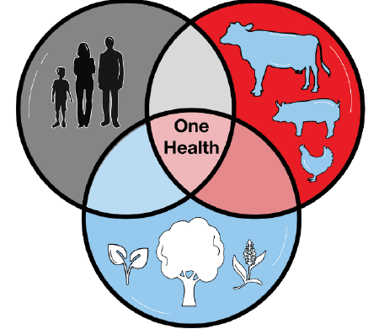
Presidential Vision:
Expand and strengthen ASN reach and impact, through global partnerships and One Health approach connecting nutrition to food systems/agriculture and health

Slide 5
Presidential Priorities
Expanding ASN’s leadership role in advocacy, policy, and education in the US and globally to support its members
Broadening the scope of nutrition through the transdisciplinary paradigm/lens of One Health
Advancing ASN’s global connections and partnerships
Organizing regional conferences and workshops on specific topics related to basic and translational nutrition

Slide 6
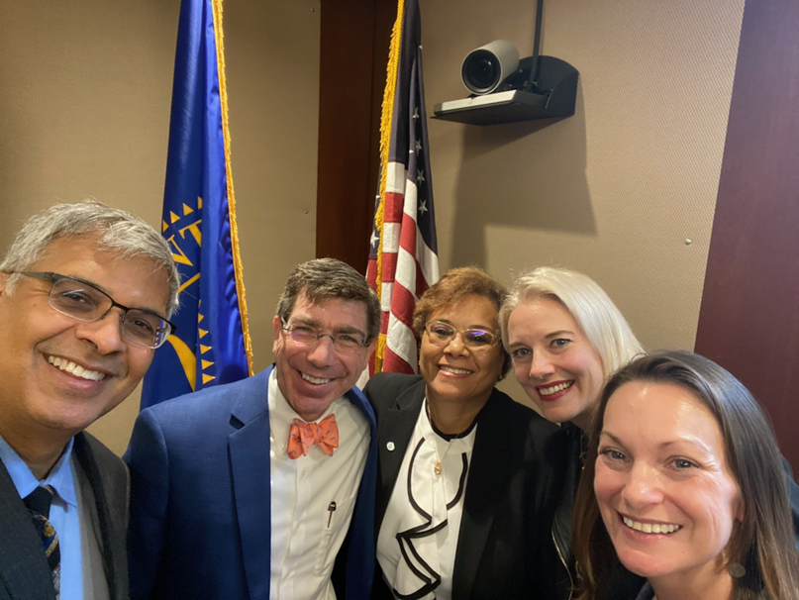
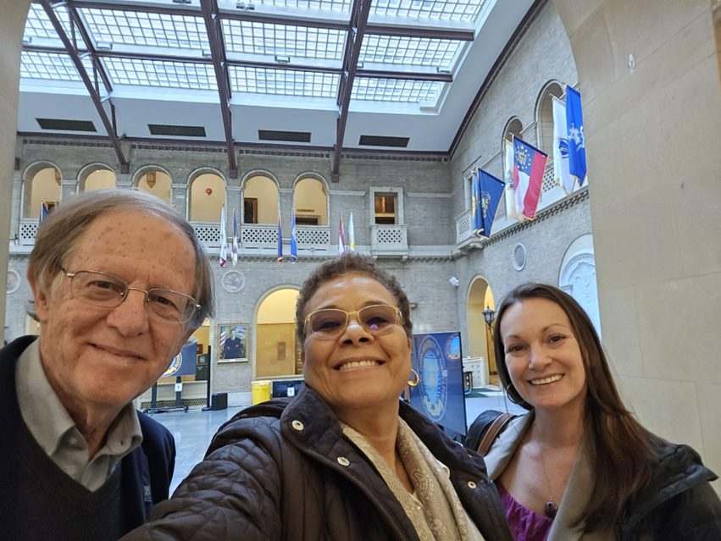

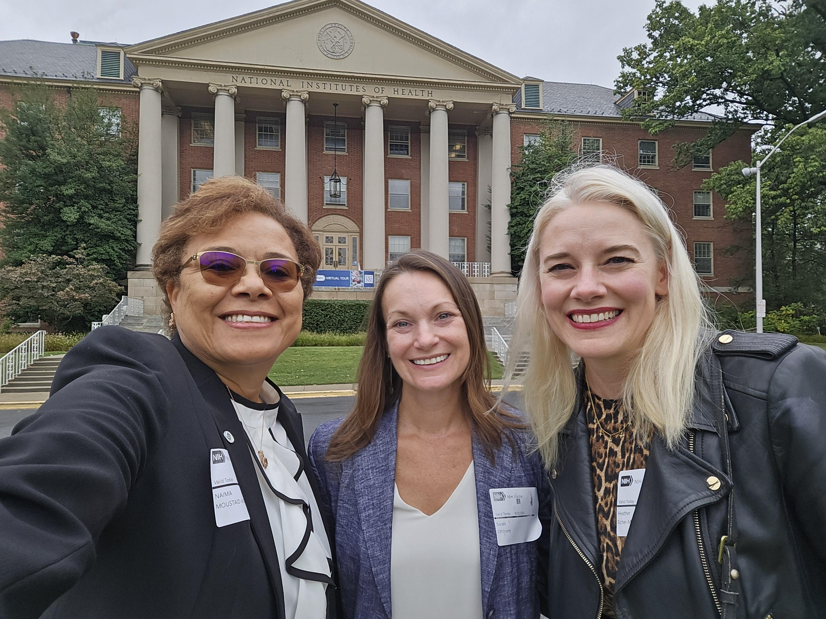
1. Expanding ASN’s leadership role in advocacy, policy & education to support its members
Historical record-breaking ASN membership with over 9,000 members
Partnership with ANDP/ASNF: Presidential scholarships
Global partnerships
Response to various federal policies
Promote/share ASN work/expertise with federal agencies (NIH & USDA visits; Friends of ONR coalition)

Slide 7
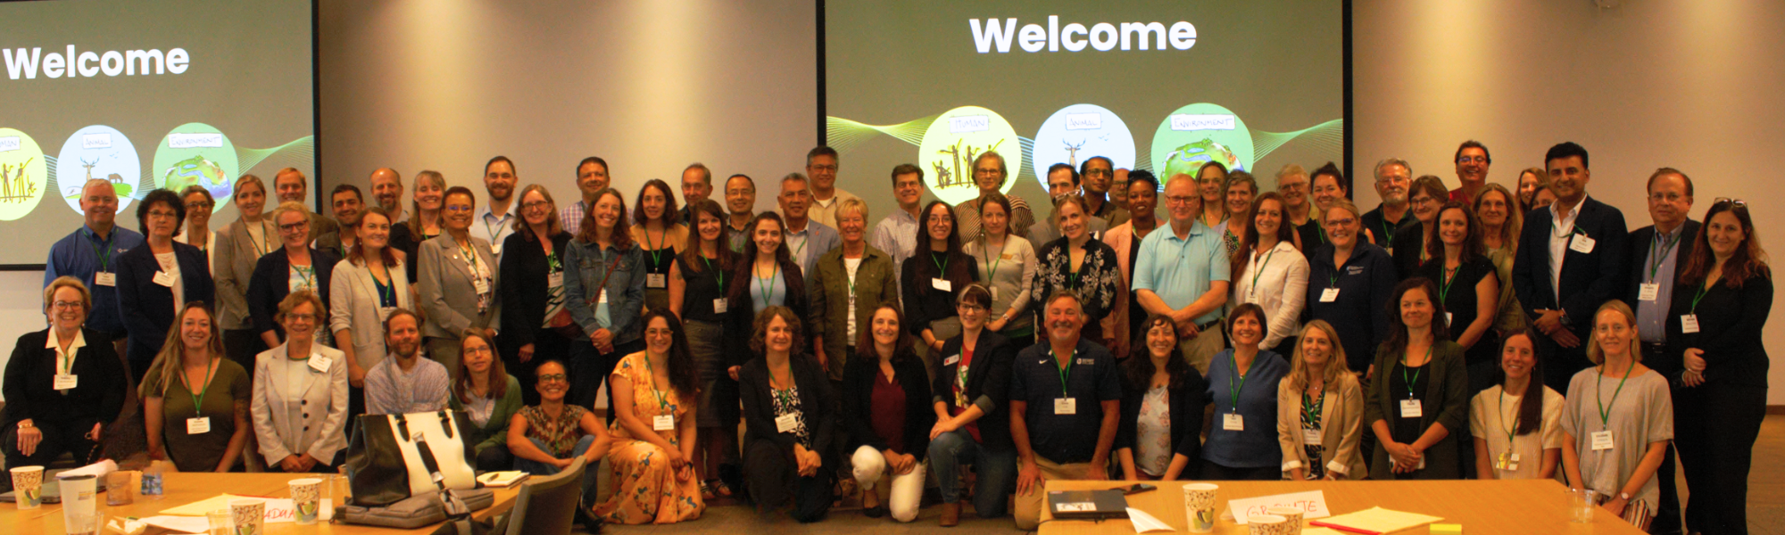
2. Broadening the scope of nutrition through the transdisciplinary paradigm of One Health
One Health JN special issue: due date Jul 31, 2026
One Health presentations at IUNS congress, SMNSE (Moroccan Society for Nutrition, Health & Environment, the 2026 Asian American Nutrition and Health Summit (>5,000 participants)
One Health related programming at Nutrition 2026:
  One Health abstract topics
  Presidential session on Global One Health, Food systems & Nutrition
  Exploring potential partnership with NAOHUN – North America One Health University Network focused on One health

Slide 8
3. Advancing ASN’s global connections and partnerships
  Goals are (1) support nutrition science and evidence-based nutrition, and (2) enhance global nutrition knowledge, exchange, capacity building, networks & opportunities for early career/ student members by:
    Sharing ASN information (GEMs, membership, publications, DISCOVER Nutrition, ASN Table)
    Increasing ASN membership and global participation in Nutrition meetings
    Enhance ASN visibility, globally (IUNS, FANUS, SMNE, ENA, MENA, FEPANS, Asia)
    Long term goal: Develop strategic alliances through joint educational activities, mentoring, nutrition science funding, and policy/advocacy
    Expand interest and collaborations related to Nutrition, Food Systems & One Health

Slide 9
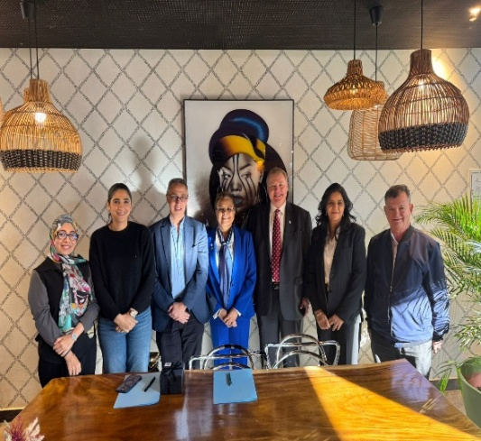
3. Advancing ASN’s global partnerships
Moroccan Society for Nutrition Health & Environment (SMNSE): Signed MOU
Emirates Nutrition Association (ENA) – MOU signing in process
  Ongoing discussions: ENA Leadership & MENA conferences
The Obesity Society (TOS): Strategic alliance signed
Society for Nutrition Education & Behavior (SNEB):
  Strategic alliance discussions in progress
NASEM Food Nutrition and Agriculture (FNA) Program: N26
International Atomic Energy Agency (IAEA):
  Ongoing discussion on partnership with IAEA to include relevant global societies
Nutrition & One Health strategic alliances:
  Consultative Group on International Agricultural Research (CGIAR)
    ED is Co-guest editor JN special issue & Keynote at N26 Presidential keynote
  FAO and WHO: N26 Presidential session panel
Federation of African Nutrition Societies (FANUS), Nutrition Society of South Africa (NSSA) & North American Chinese Association for Nutrition (NACAN)
ASN/SMNSE

Slide 10
4. Organizing regional conferences and workshops on specific topics related to nutrition
Re-engage more basic science and translational scientists in ASN and recruit members from relevant organizations and partners:
Topical conferences in collaboration with ANDP
  Nutrition conferences at ANDP institutions, co-sponsored by ASN
  Conference co-sponsored by ASN, at OSU: 22nd Russell Klein Nutrition Research Symposium (March 31, 2026, Columbus, OH)
Regional & global conferences co-sponsored with our partners (John):
  SMNSE, ENA, TOS, and NACAN (North American Chinese Association for Nutrition)

Slide 11
Other remarkable ASN accomplishments
Impressive abstract submissions and registration for NUTRITION 2026
New awards through the ASN Foundation
New virtual membership mentoring platform
Partnership with multiple organizations to support nutrition science, evidence-based nutrition, early career members, and overall impact (Bangladesh, ME, South Asia, UNICEF)
Friends of ONR (Office of Nutrition Research)
LANTERN
Support LANTERN proposed action plan on rigor in designing animal diets Successful partnership and collaboration with ASNF
ASN Centennial Planning
Record breaking engagement of Sustaining Partners

Slide 12
Impactful Achievements in Clinical Nutrition
New Physician GEM
WHO New ICD Code for Undernutrition in Clinical Settings for Adults
National Board of Physician Nutrition Specialists (NBPNS)
The Centers for Medicare and Medicaid Services (CMS) recently approved a Medicare physician specialty code for Physician Nutrition Specialist after ASN advocacy:
  A huge policy win for patients/physicians who will get reimbursed for nutrition care
  Elevates the ASN-affiliated NBPNS to attract more MDs to obtain this credential
  Process: (1) new specialty code is assigned, and appropriate system changes are made; (2) implementation, may take up to a year; (3) PNS in general medicine, internal medicine, surgery, pediatrics, and anesthesiology may bill for nutrition services

Slide 13
Summary of ASN member Survey
Distributed early in 2026; 382 responses received (6% response rate)
Top benefits:
  Nutrition meetings, journals & networking
  Opportunities to contribute to the nutrition field
Top Challenges
  Lack of funding, publishing costs, misinformation, and policy/regulatory barriers
  Specific to early career members:
    Finding a mentor, networking, finding collaborators, and job hunting
Summary and Action Plan:
  Overall satisfaction with ASN membership experience [Top 5% in 501(c)(3)]
  Differences in needs/perceived benefits among different career stages
  ASN’s staff (membership/marketing) are using this insight to develop messaging approaches to engage current and recruit new members

Slide 14

Acknowledgments
Dedicated ASN members
Presidential line, Secretary, Treasurer, all BOD members who have been my exceptional partners
All of the GEM leaders, Committee chairs and members who volunteer their time and expertise to advance the society
Our phenomenal Editors, Associate Editors, Academic Editors and the thousands of volunteer reviewers who help us publish all of the sound Nutrition science
One-of-a-kind Paul for his stellar leadership of the Foundation, Felicia, and the ASNF Board of Trustees
Our strategic alliance partners ( ANDP, NBPNS, Sustaining Partners), our partners in Government, Industry, Sister Nutrition/Health focused Organizations around the globe
Our Exceptional ASN staff- led by another one-of-a-kind CEO, John. Special call out to extraordinary Erica and the whole ASN team whose passion, dedication and exceptional enthusiasm to ASN is second to none “exceptional staff”
Sophia Peña at TTU, for being my rock, gatekeeper & making sure everything is in order
Amazing husband, Hanna for being my best support system and entertainer!

Slide 15

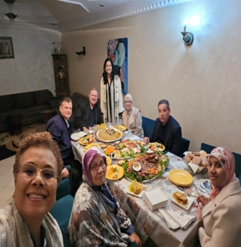
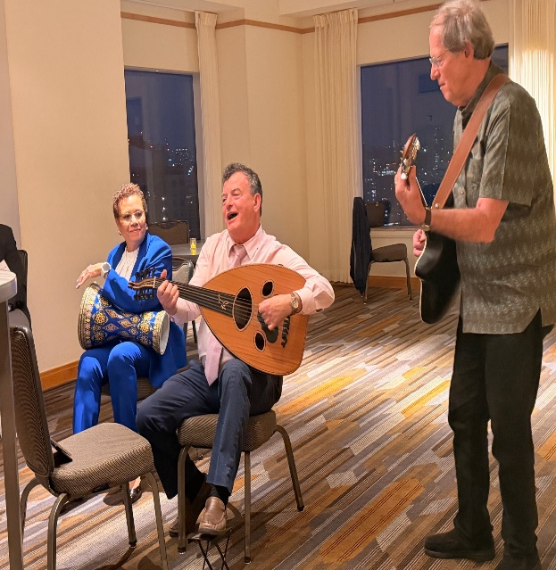
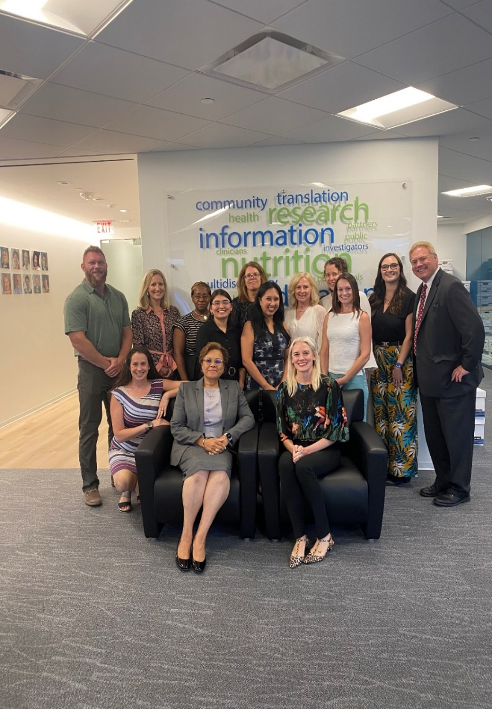
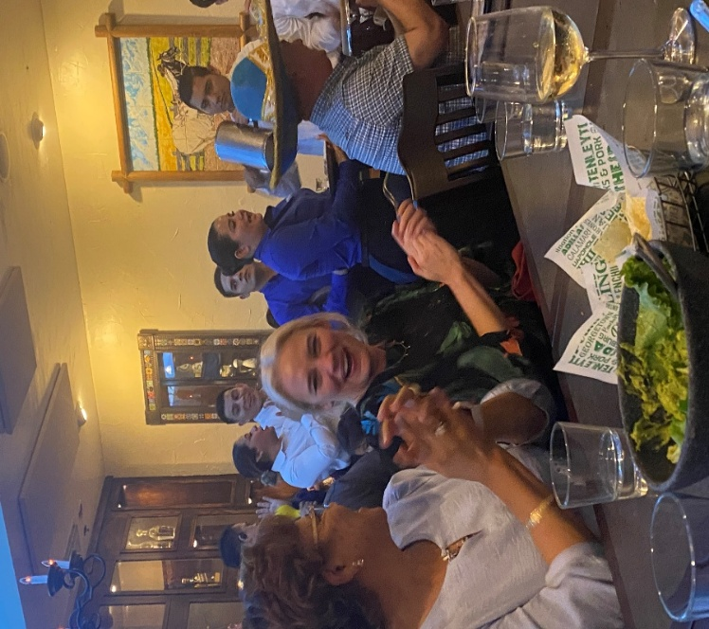
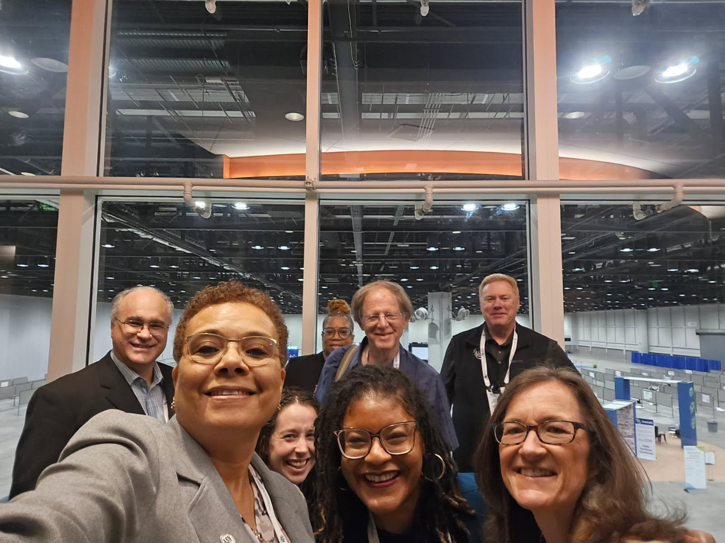
Istockphoto.com

