Slide 1

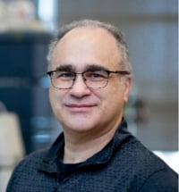
Treasurer’s Report
2025 – 2027
Robert Bertolo, PhD
Professor of Nutrition and Head of the Department of Biochemistry at Memorial University of Newfoundland
ASN Treasurer

Slide 2
Net Assets 2005 – 2025
(millions of dollars)
2005 2025 Unaudited

Slide 3
Revenue 2005 – 2025
(millions of dollars)
2005 2025 Unaudited

Slide 4
Finance and Audit Committee
TREASURER
Robert Bertolo, PhD
Term: 25-27
STAFF
John Courtney, PhD and Carolyn Skinner, CPA
CEO CFO
COMMITTEE MEMBERS
Anthony Basile, DTR, PhD, RDN, CDN
Term: 21-26
Sai Krupa Das, PhD
Term: 22-27
Erin Glynn, PhD
Term: 23-27
Dmitri Sitnikov, PhD
Term: 25-28

