Slide 1
Nutrition in Cancer Prevention and Survival
Wendy Demark-Wahnefried, PhD, RD
Professor Emerita of Nutrition Sciences
University of Alabama at Birmingham
American Cancer Society Clinical Research Professor

Slide 2

Objectives
Develop awareness of current cancer-related statistics
Recall and understand current dietary guidelines for cancer prevention and control
Seize opportunities to improve diet among individuals at high risk for cancer or its recurrence

Slide 3
Disclosures
AFFILIATION/FINANCIAL INTERESTS | ENTITIES
Grants/Research Support | American Cancer Society National Cancer Institute

Slide 4
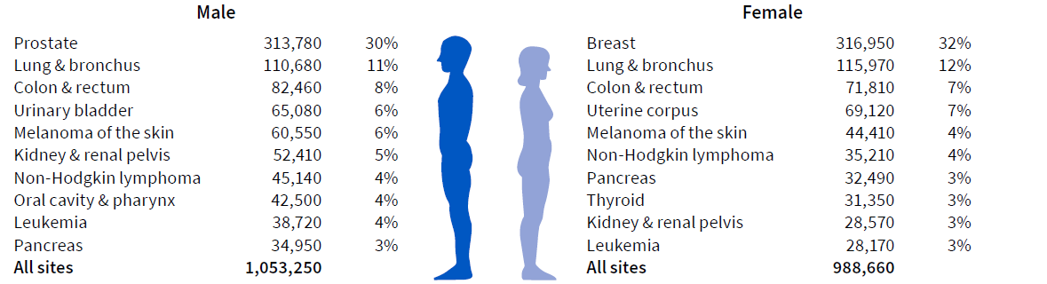
Estimated number of new cancer cases in the US in 2025
Excludes basal cell and squamous cell skin cancers and in situ carcinoma except urinary bladder.
Source: Cancer Facts & Figures 2025.
©2025, American Cancer Society, Inc., Surveillance and Health Equity Science
Notes:
In 2025, a little over 2 million new cancer cases are expected to be diagnosed in the United States. Prostate cancer is the most common cancer among males (30%), followed by lung (11%) and colorectal (8%) cancers. Among females, breast (32%), lung (12%), and colorectal (7%) cancers are the most common.

Slide 5
Trends in five-year relative survival (%), US, 1975-2020
Site | 1975-77 | 1995-97 | 2014-2020
All sites | 49 | 63 | 69
Breast (female) | 75 | 87 | 91
Colon & rectum | 50 | 61 | 64
Leukemia | 34 | 48 | 67
Liver & intrahepatic bile duct | 3 | 7 | 22
Lung & bronchus | 12 | 15 | 27
Melanoma of the skin | 82 | 91 | 94
Non-Hodgkin lymphoma | 47 | 56 | 74
Ovary | 36 | 43 | 51
Pancreas | 3 | 4 | 13
Prostate | 68 | 97 | 97
Uterine cervix | 69 | 73 | 67
Uterine corpus | 87 | 84 | 81
Survival is age adjusted for normal life expectancy and are based on cases diagnosed in the Surveillance, Epidemiology, and End Results (SEER) 9 areas for 1975-1977 and 1995-1997 and in the SEER 22 areas for 2014-2020; cases followed through 2021.
Data source: Surveillance, Epidemiology, and End Results program, National Cancer Institute, 2025.
©2025, American Cancer Society, Inc., Surveillance and Health Equity Science
Notes:
This table shows the 5-year relative survival rate by cancer site. There have been notable improvements in survival for most cancer types due to earlier detection and/or advances in treatment. Overall cancer survival has increased from 49% in the mid-1970s to 69% for diagnoses during 2014-2020.

Slide 6
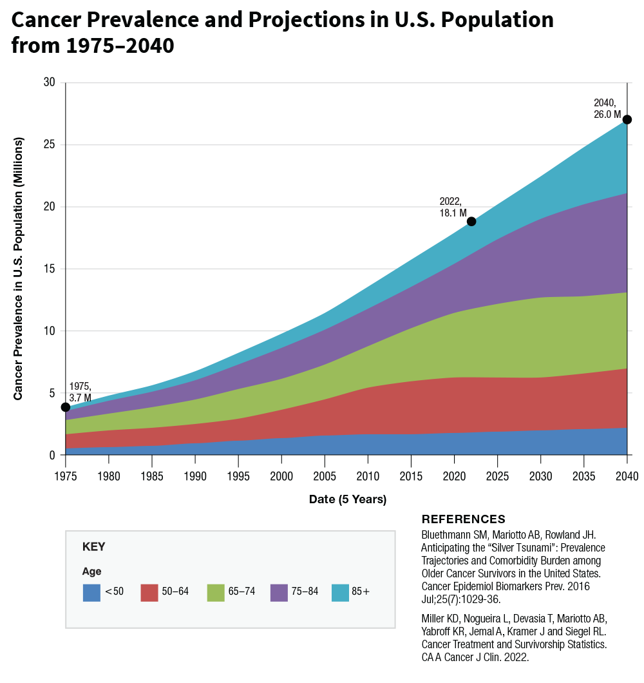
Net Result: The Number of Cancer Survivors
are Increasing

Slide 7
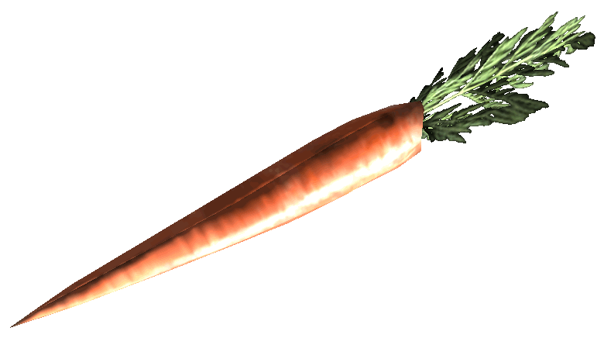

Cancer Survivorship: The Bad News
Cancer Survivors at greater risk
- Progressive disease
- Second primaries
- Cardiovascular Disease
- Diabetes
- Osteoporosis
- Sarcopenia
- Functional decline
Notes:
2004, total economic burden of cancer estimated at $190 Billion – 64.2 B attributed to direct cancer care costs

Slide 8
Dietary for Cancer Prevention & Control
 | WCRF- AICR (2018) | American Cancer Society (2020/2022)
Weight | Be a healthy weight (avoid weight gain in adulthood) | Achieve & maintain a healthy weight throughout life
Dietary Pattern | Eat a diet rich in whole grains, vegetables, fruits and beans (prudent diet) Limit Fast foods” and other processed foods high in fat, starches or sugars Red & processed meats (12-18 oz/week) Sugary drinks | Follow a healthy eating pattern at all ages High nutrient foods in amts to achieve a healthy wt; A variety of dark green, orange or red vegetables, legumes (beans and peas), and others; Fruits, especially whole fruits in a variety of colors; and Whole grains. Limit or avoid Red and processed meats; Sugar‐sweetened beverages; or Highly processed foods & refined grains
Alcohol | Limit alcohol. If drink limit to 1-2 drinks/day | Best not to drink alcohol
WCRF-AICR 3rd Expert Report 2018 https://www.wcrf.org/;
Rock CL et al. CA J Clin 70: 245-71; 2020; Rock CL et al. CA Cancer J Clin. 2022 Mar 16. doi: 10.3322/caac.21719.

Slide 9
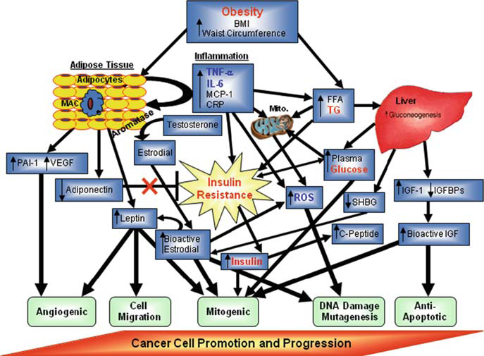
Identified Mechanistic Pathways through which Excess Adiposity promotes Cancer
Nock NL, Berger NA. Obesity and Cancer: - NA Berger, Springer 2010

Slide 10
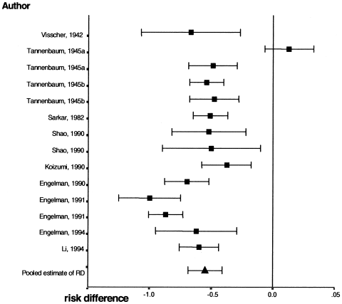
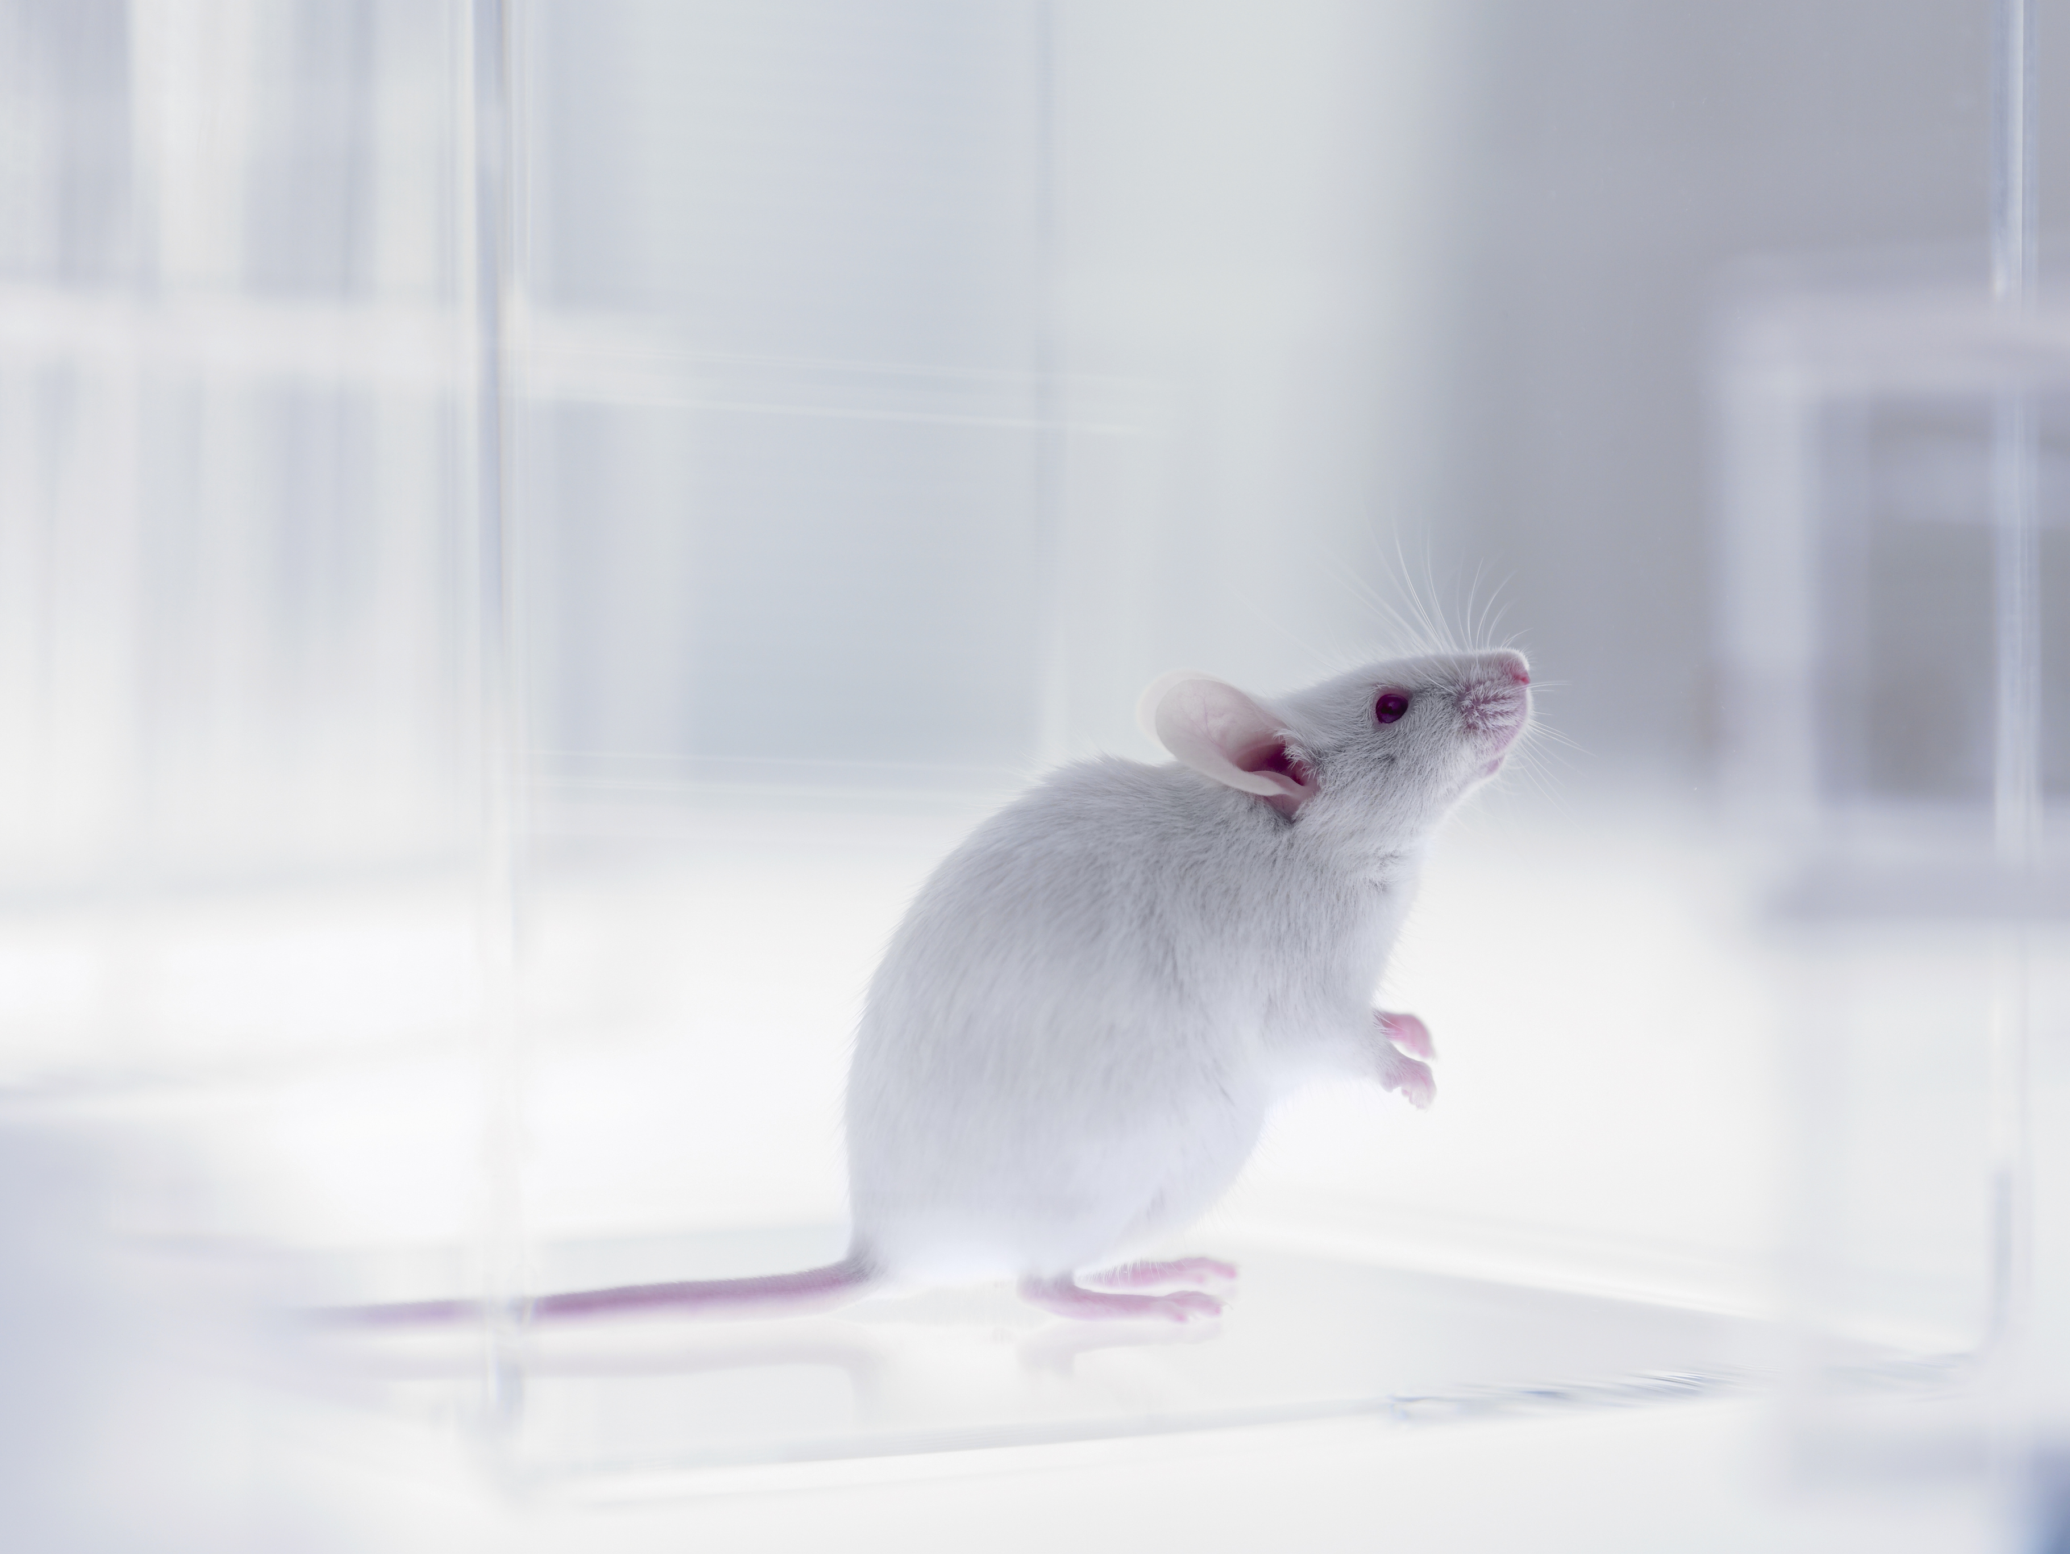
Calorie Restriction Consistently Inhibits Cancer in Preclinical Models
1909 Moreschi finds that rodents with transplanted, spontaneous, and chemically-induced tumors live significantly longer on energy-restricted diets
Protective effect of energy restriction on cancer incidence and progression gains almost universal acceptance
Most studies have restricted calories to 60-70% of ad libitum levels
Dirx et al. Int J Cancer 2003

Slide 11
Obesity and Relative Risk of Cancer

Slide 12
Evidence that Weight Loss Reduces Cancer Risk
•
0.81
Breast Cancer
•
0.91
Colon Cancer
•
0.96
Endometrial Cancer
•
0.96
Obesity-Related Cancers: Breast, colon, endometrial & kidney
0.0
0.2
0.4
0.6
0.8
1.0
1.2
1.4
Parker et al. Intl J Obes Relat Metab Dis 27: 1447-52, 2003
Concordance in Miyagi Cohort (>10,000 Japanese women) - Kawai et al. Br. J Cancer Sept 2010

Slide 13
Obesity and Poor Prognosis

Slide 14
Obesity and Mortality in Solid Tumors
Type of Cancer | Number of Cohorts | Overall Mortality (HR, 95%CI) | Number of Cohorts | Cancer-Specific Mortality (HR, 95%CI)
Breast | 59 | 1.26 (1.20–1.33) | 36 | 1.23 (1.15–1.32)
Colorectal cancer | 30 | 1.22 (1.14–1.31) | 13 | 1.24 (1.16–1.33)
Pancreas | 6 | 1.36 (0.95–1.93) | 3 | 1.28 (1.05–1.57)
Endometrial cancer | 12 | 1.20 (1.04–1.38) | 6 | 1.02 (0.75–1.39)
Prostate cancer | 12 | 1.07 (0.91–1.25) | 15 | 1.26 (1.08–1.47)
Gastroesophageal cancer | 7 | 1.08 (0.77–1.52) | 2 | 0.83 (0.58–1.16)
Bladder cancer | 3 | 1.08 (0.98–1.20) | 3 | 1.36 (0.96–1.93)
Hepatobiliary cancer | 5 | 1.06 (0.89–1.25) | 1 | 0.79 (0.50–1.24)
Ovarian cancer | 4 | 1.03 (0.75–1.41) | 4 | 1.06 (0.82–1.37)
Pati S, Irfan W, et al. Cancers (Basel). 2023 Jan 12;15(2):485. doi: 10.3390/cancers15020485:
Petrelli F., Cortellini A., et. al. JAMA Netw. Open. 2021;4:e213520. doi: 10.1001/jamanetworkopen.2021.3520

Slide 15
Weight Gain and Prognosis After Diagnosis Results of 2 Meta-Analyses
Group (year) | # of studies | Sample | RR (95% CI) for every 5 kg/m² increase in BMI from pre- to post-dx
Chan et al. (2014) | 82 | 213,075 women with breast cancer | Breast CA Specific Mortality 1.29 (0.97-1.72) Total Mortality 1.08 (1.01-1.15)
Cao & Ma (2011) | 6 cohort | 18,203 men with prostate cancer | Biochemical Recurrence 1.21 (1.11-1.31) Prostate CA Specific Mortality 1.20 (0.99-1.46)

Slide 16
Purposeful Weight Loss Improves Survival
in the General Population
Group (year) | # of studies | Sample | Risk Ratio for All Cause Mortality
Ma et al. (2017) | 54 RCTs | 30,206 adults with obesity | 0.82 (95% C.I. 0.71 – 0.95)
But…
Will purposeful weight loss improve cancer-related outcomes and survival in populations with cancer? – waiting on results of BWEL and LiVES
_{Ma C et al. BMJ 359: 2017}

Slide 17
Dietary for Cancer Prevention & Control
 | WCRF- AICR (2018) | American Cancer Society (2020/2022)
Weight | Be a healthy weight (avoid weight gain in adulthood) | Achieve & maintain a healthy weight throughout life
Dietary Pattern | Eat a diet rich in whole grains, vegetables, fruits and beans (prudent diet) Limit Fast foods” and other processed foods high in fat, starches or sugars Red & processed meats (12-18 oz/week) Sugary drinks | Follow a healthy eating pattern at all ages High nutrient foods in amts to achieve a healthy wt; A variety of dark green, orange or red vegetables, legumes (beans and peas), and others; Fruits, especially whole fruits in a variety of colors; and Whole grains. Limit or avoid Red and processed meats; Sugar‐sweetened beverages; or Highly processed foods & refined grains
Alcohol | Limit alcohol. If drink limit to 1-2 drinks/day | Best not to drink alcohol
WCRF-AICR 3rd Expert Report 2018 https://www.wcrf.org/;
Rock CL et al. CA J Clin 70: 245-71; 2020; Rock CL et al. CA Cancer J Clin. 2022 Mar 16. doi: 10.3322/caac.21719.

Slide 18
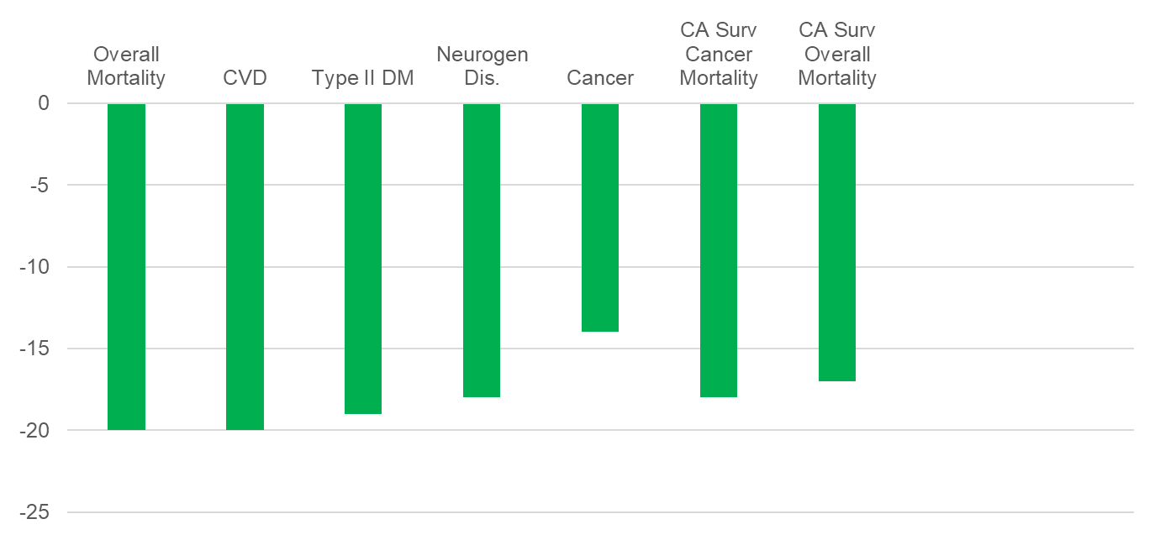
How Important is Diet Quality?
Meta-analysis of 113 studies (n = 3,277,684)
Morze J et al. J Acad Nutr Diet 120(12):1998-2031, 2020

Slide 19
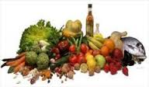
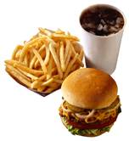
Prudent vs. Western Dietary Patterns in Cancer Survivors
Team (year) | Sample | Diet | CA Mortality HR (95% CI) | All Cause Mortality HR (95% CI)
Kroenke (2005) | 2619 Breast CA | Prudent | 1.07 (0.66-1.73) | 0.54 (0.31-0.95)
 |  | Western | 1.01 (0.60-1.70) | 2.31 (1.23-4.32)
Kwan (2009) | 1901 Breast CA | Prudent | 0.79 (0.43-1.43) | 0.35 (0.17-0.73)
 |  | Western | 1.20 (0.62-2.32) | 2.15 (0.97-4.77)
Vrieling (2013) | 2522 Breast CA (post) | Prudent | 0.89 (0.59-1.35) | 0.81 (0.40-1.61)
 |  | Western | 3.69 (1.66-8.17) | 0.99 (0.64-1.52)
Meyerhardt (2007) | 1009 Stage III CRC | Prudent | 1.13 (0.77-1.67) | 1.32 (0.86-2.04)
 |  | Western | 2.85 (1.75-4.63) | 2.32 (1.36-3.96)
Schwedhelm (2016) | Meta-analysis | Prudent | - | 0.77 (0.60-0.99)
 |  | Western | - | 1.51 (1.24-1.85)

Slide 20
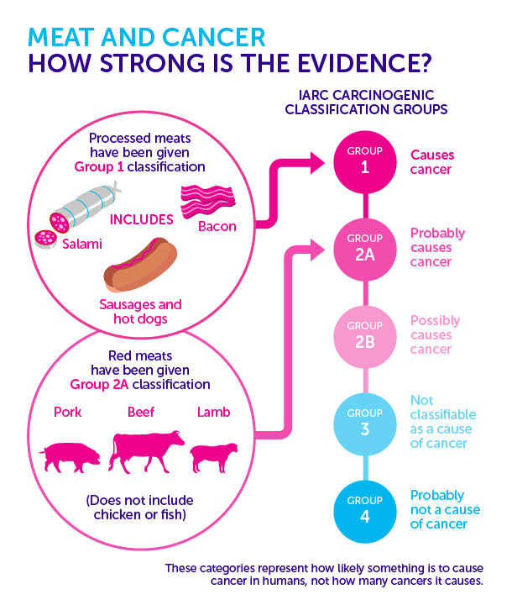
October 26, 2015 IARC declared:
“Red meat is a carcinogen”
Pooled analysis of 37,698 men from the Health Professionals Follow-up Study and 83,644 women from the Nurses' Health Study
9464 cancer deaths during 2.96 million person-years of follow-up.
If substitute fish, poultry, nuts, legumes, low-fat dairy for red meat would equate with a 7% to 19% lower mortality risk.
RX: No more than 12-18 oz/week

Slide 21
Dietary for Cancer Prevention & Control
 | WCRF- AICR (2018) | American Cancer Society (2020/2022)
Weight | Be a healthy weight (avoid weight gain in adulthood) | Achieve & maintain a healthy weight throughout life
Dietary Pattern | Eat a diet rich in whole grains, vegetables, fruits and beans (prudent diet) Limit Fast foods” and other processed foods high in fat, starches or sugars Red & processed meats (12-18 oz/week) Sugary drinks | Follow a healthy eating pattern at all ages High nutrient foods in amts to achieve a healthy wt; A variety of dark green, orange or red vegetables, legumes (beans and peas), and others; Fruits, especially whole fruits in a variety of colors; and Whole grains. Limit or avoid Red and processed meats; Sugar‐sweetened beverages; or Highly processed foods & refined grains
Alcohol | Limit alcohol. If drink limit to 1-2 drinks/day | Best not to drink alcohol
WCRF-AICR 3rd Expert Report 2018 https://www.wcrf.org/;
Rock CL et al. CA J Clin 70: 245-71; 2020; Rock CL et al. CA Cancer J Clin. 2022 Mar 16. doi: 10.3322/caac.21719.

Slide 22
Association between Alcohol and Cancer is Linear No amount “safe”

Slide 23
Adherence of Dietary Guidelines among the General Population and Cancer Survivors
Domain | General Population | Cancer Survivors
BMI 25+ | 74% | 71.6%
<5 Servings of F&V d⁻¹ | 90% | 66%
Suboptimal Fiber Intake | 95% | 69%
Excessive Red & Processed Meat Consumption | 63-74% | 53%
Moderate-to-Heavy Alcohol Consumption | 20.6% | 17%
CDC 2019/2025/2020; Quaglini & Felt Gunderson, Am J Lifestyle Med. 11:85-89, 2019; Frank et al. Public Health Nutrition, 25: 1-10, 2022;
NCI 2025; Tollosa et al. J Cancer Surv. 13:327-343, 2019

Slide 24

J Clin Oncol 40:2491-2507. © 2022 by American Society of Clinical Oncology
Synthesis of 52 systemic reviews and 23 RCTs ~3/4 ‘s of source documents were exercise related
Providers should Rx aerobic and resistance exercise (Strength of Rx: Strong)
Preserves cardiorespiratory fitness, physical function and strength
↓ Fatigue, as well as anxiety, depression in some populations
↑ QoL in some populations
2) Insufﬁcient evidence to Rx for or against dietary interventions (including weight management)
EXCEPTION: Neutropenic diets (i.e., exclusion of raw fruits and vegetables) NOT Rx

Slide 25

Cancer can Provide a Teachable Moment
988 Breast and Prostate Cancer Survivors
Demark-Wahnefried et al. Cancer. 88:674-84, 2000.
2022
Counseling should begin ASAP after diagnosis to…
avoid nutrient deficiencies
preserve muscle mass
tolerate and respond to treatment
manage side effects
prevent chronic disease
216 Teenage and Young Adult Cancer Survivors
Pugh G et al. J Adolesc Young Adult Oncol. 6:318-26, 2017.

Slide 26
Seize the Teachable Moment !
Vast literature showing the powerful influence of MD advice on health behavior.
92% of cancer survivors prefer to receive guidance from their oncology team while receiving care at the cancer center Philip E et al. Supp Care Cancer 2014
Smoking (USPSTF Ask, Advise, Assess, Assist, Arrange)
ASK: Have you heard about the evidence about diet and cancer?
ADVISE: Orient them to BMI chart or point-out current behaviors
ASSESS: Current readiness
ASSIST: Set a start date
ARRANGE: Refer or provide materials

Slide 27

Brochures can make an impact
Daughters And MothErS (DAMES) Trial shows controls who received 5 brochures over a year…
2 pound weight loss in mothers with breast cancer and 6 pound loss in their daughters
1 cm loss in waist circumference for both
Daughters increased their physical activity by 24.9 minutes per week.
CA122143
Demark-Wahnefried et al. Cancer 120:2522-34, 2014
Notes:
These were delivered by mail and not by you…..No firm data to back this up but I would venture guess that the effect would be greater

Slide 28

There are online resources
https://survivorshine.org
Notes:
Some very nice websites.
Issues patients want something that engages them (people like me)
Use for awhile – print out food diary and exercise log and bring in.

Slide 29

Internet-Based Lifestyle Intervention to Eradicate Obese Frailty in Prostate Cancer Survivors
Call: 833-880-6800
Website: ilive4health.org
Email: iLIVE4health@ohsu.edu
NCT06011499
National Cancer Institute: R01 CA275055

Slide 30
Thanks for
Your Attention
– Any questions?
R21 CA161263
R21 CA178359

