Slide 1









Nutrition Considerations with the Long-Term Use of GLP-1 RA
PRESENTED BY
FATIMA CODY STANFORD, MD, MPH, MPA, MBA, MACP, FAAP, FAHA, FAMWA, FTOS
Massachusetts General Hospital and Harvard Medical School

Slide 2
Disclosures
Advisory Boards:
Eli Lilly, Novo Nordisk, Amgen, Currax, Pfizer,Vida Health, Ilant Health, Doximity, Calibrate, GoodRx, MelliCell, Empros Pharma, Clearmind Medicine, Sweetch, Apnimed
Research Support:
Eli Lilly

Slide 3
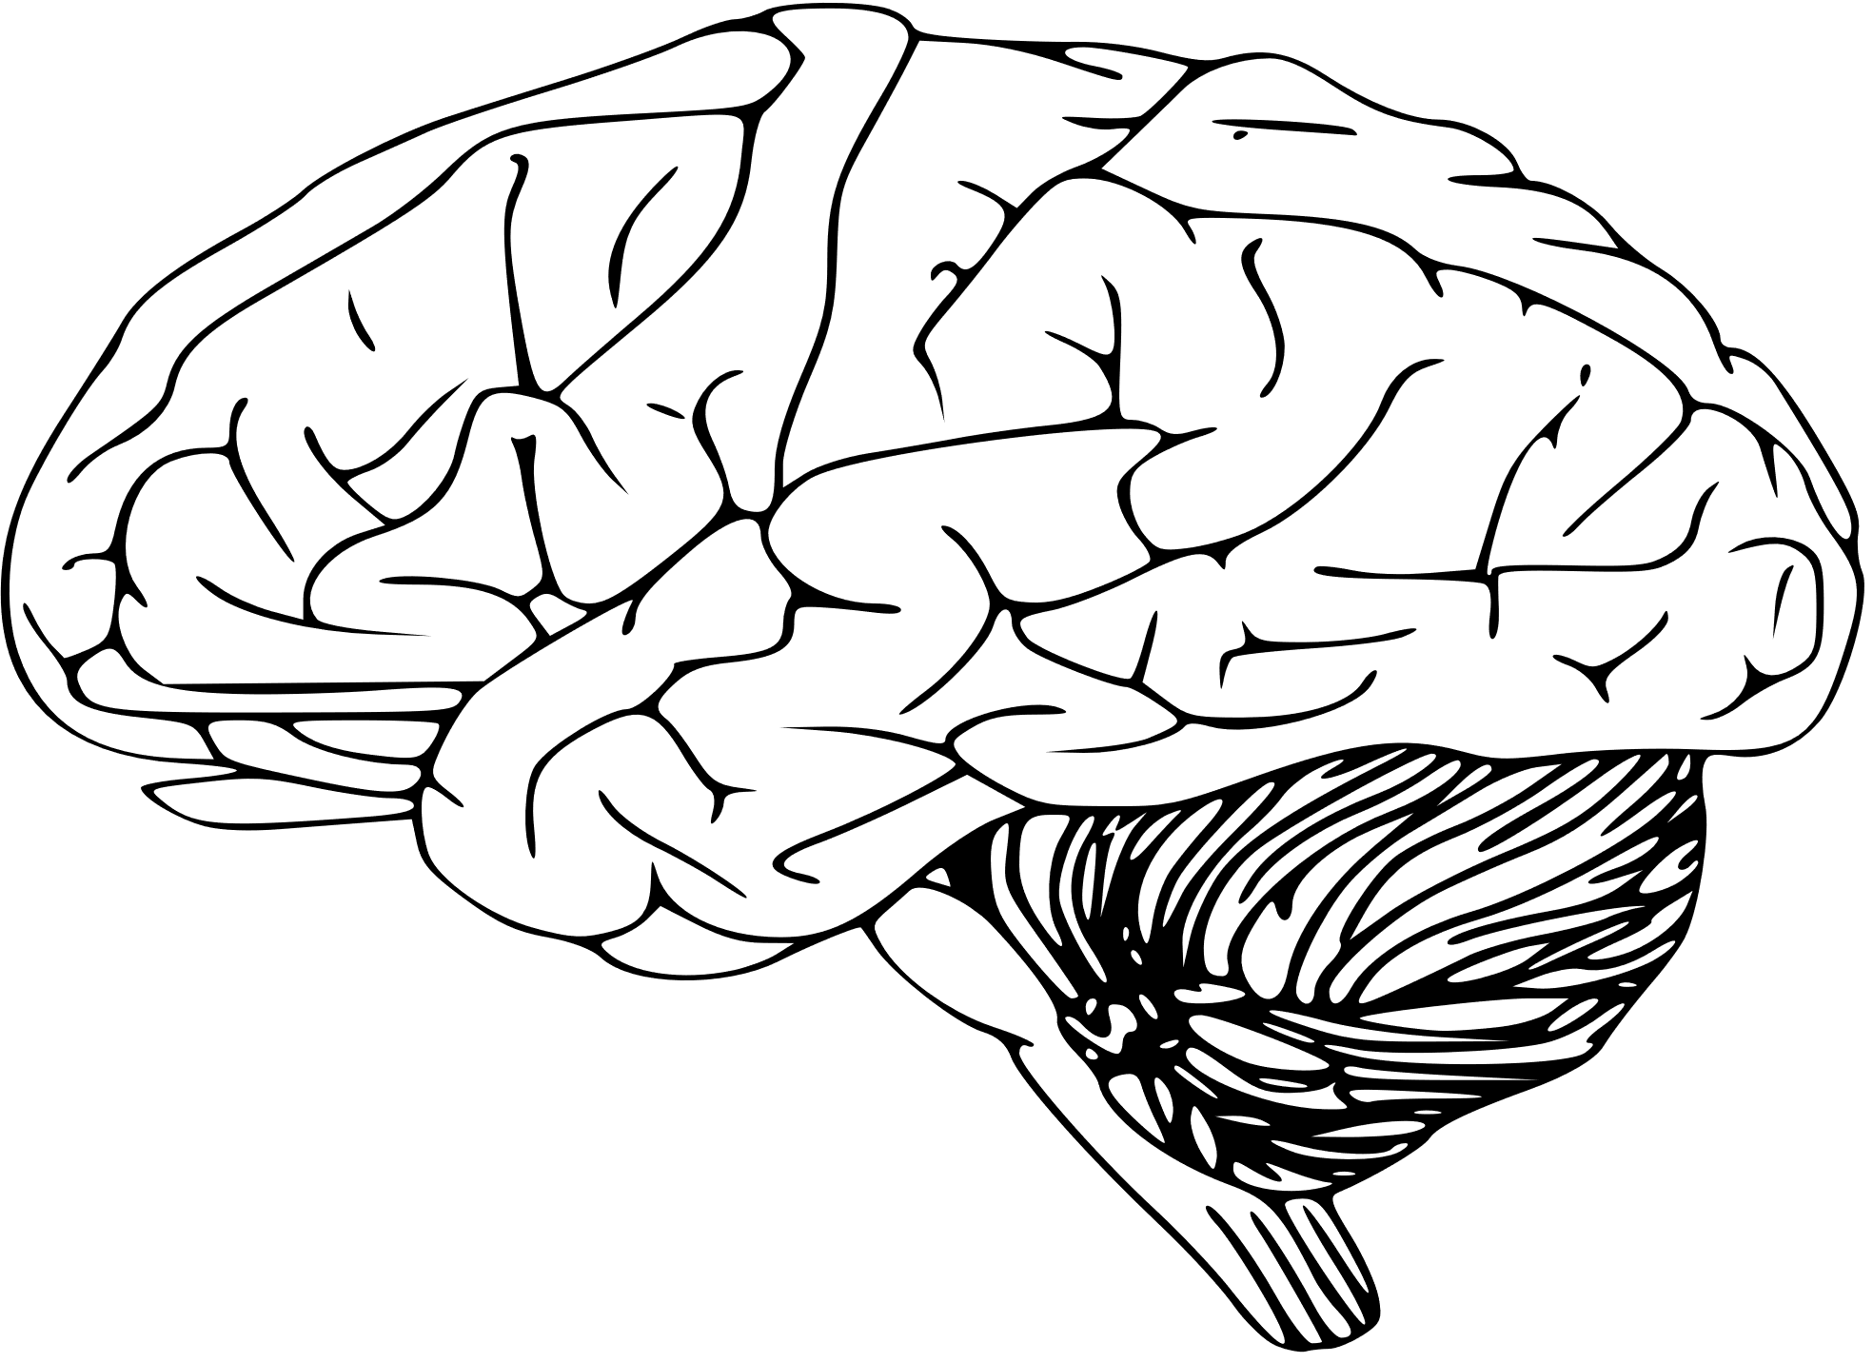
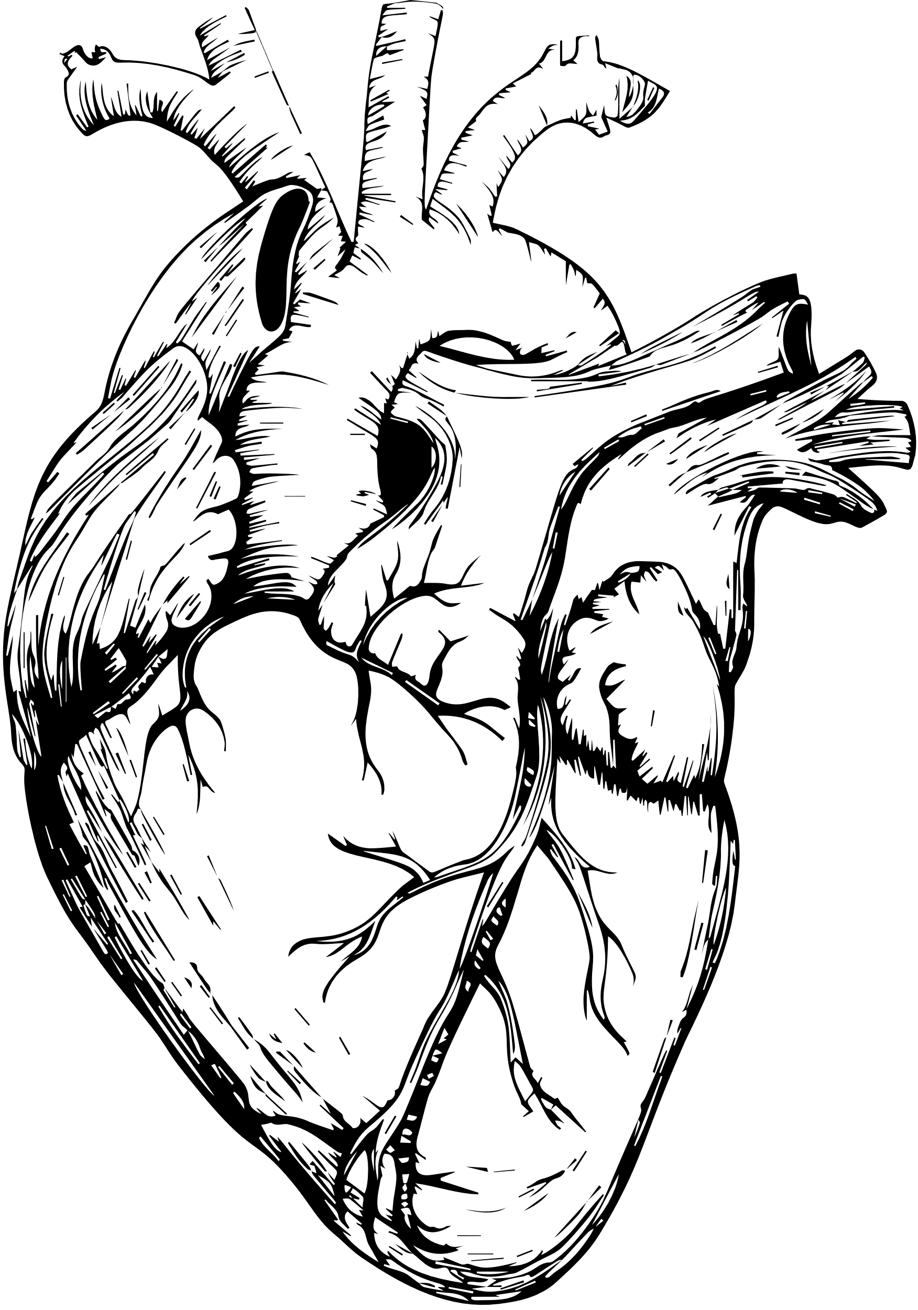


Objectives
FATIMA CODY STANFROD
PRESENTED BY
Prevalence of Obesity
GLP-1 Pathophysiology, Diet Impact, Side Effects
Explore the international prevalence of obesity.
Learn about GLP-1 pathophysiology, impact on dietary patterns, management of side effects
Evaluation of Nutrient Deficits, Bone and Muscle Health
GLP-1 Efficacy and Lifestyle Modification
Determine ways to mitigate nutrient deficiencies and promote bone and muscle health.
Ascertain the efficacy of GLP-1s and lifestyle modifications on GLP-1s.
Framework to Support GLP-1s and Components on Nutritional Screening
Dietary Recommendations and Telehealth Support
Establish dietary recommendations for GLP-1s and telehealth support for patients.
Evaluate the 5A’s framework to support GLP-1s and nutritional screening for patients for GLP-1 therapy

Slide 4
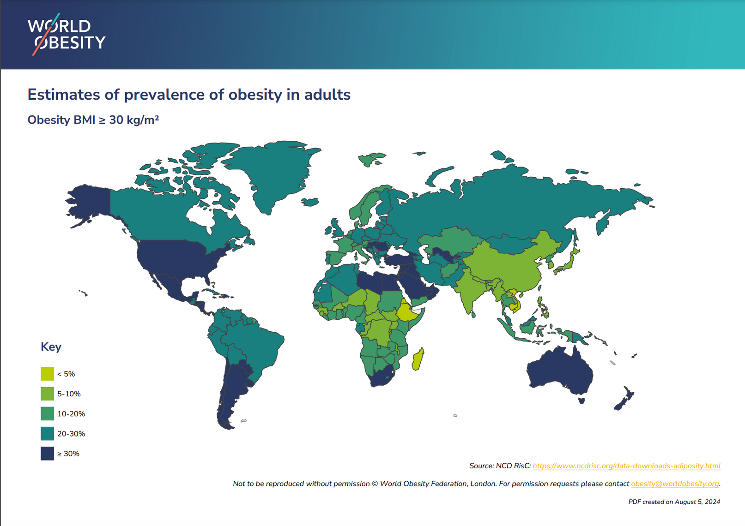
Obesity Prevalence
FATIMA CODY STANFORD
PRESENTED BY
1 Billion People Worldwide have
OBESITY

Slide 5

Global Obesity Trends
High and rising prevalence attributed to poor dietary patterns and insufficient physical activity.
Behaviors often learned early and influenced by structural barriers.
Energy Expenditure Insights
Studies (1981-2017) show increased physical activity energy expenditure but decreased basal metabolic rate.
Suggests dietary composition impacts metabolic rate and obesity risk.
Dietary Quality and Obesity
Influences metabolic adaptation, resting energy expenditure, microbiome calorie utilization, and epigenetic risk.
High-refined carbohydrate diets can increase obesity risk.
Genetic and Lifestyle Influences
Individual risk is modifiable by genetics; population trends are driven by cultural, community, and environmental factors.
Iatrogenic causes include poor diet quality or low physical activity due to medical conditions/medications.
Lifestyle Modification Programs
Effective in achieving 5-10% weight reduction.
Help maintain healthy body weight despite some uncontrollable factors.
FATIMA CODY STANFORD
PRESENTED BY

Slide 6
Impact of GLP-1s on Dietary Preferences and Intakes
FATIMA CDOY SATNFORD
PRESENTED BY
Mechanisms of Action
GLP-1s impact energy intake and food preferences through gut, brain, and diet-microbiome interactions. Influence reward behavior via GLP-1 receptors in the mesolimbic system.
Brain imaging shows changes in appetite and reward-related regions (insula, amygdala, putamen, orbitofrontal cortex).
Effects on Energy Intake
Reduction in energy intake by 16-39% compared to placebo.
Decreased cravings, hunger, and increased fullness.
Benefits include reduced food preoccupation, emotional eating, external eating, and binge eating.
Food Preferences and Cravings
Shift away from sweet, savory, starchy, and high-fat foods.
Anecdotal reports suggest an increased preference for minimally processed, nutrient-dense foods.
Dietary counseling can enhance changes, e.g., reduction in added sugars and increase in dietary protein.

Slide 7
Clinical Observations and Challenges in GLP-1 Therapy
FATIMA CDOY SATNFORD
PRESENTED BY
Clinical Observations
Reduced interest in food and cravings for high-fat, sugary foods, and alcohol.
Decrease in binge eating and food rumination.
Side effects like nausea may trigger cravings for comfort foods.
Potential Challenges
Limited food interest may lead to inadequate nutrient intake or rebound cravings.
Reduced pleasure from food can affect the quality of life and cause affective changes.
Frustration may lead to medication discontinuation.
Management Strategies
Discuss possible disordered thoughts about food and affective changes.
Consider referral to behavioral therapy for support.
Adjust the dose, agent, or class of medication as needed to optimize outcomes.

Slide 8
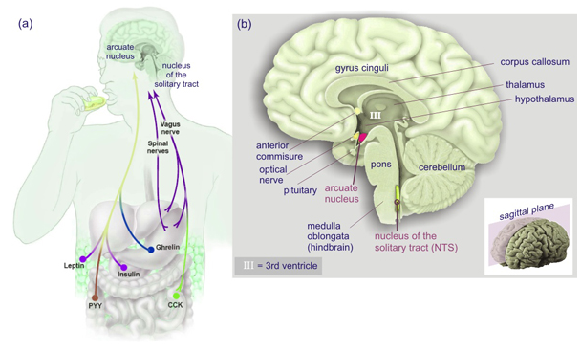
Regulation of Food Intake
http://www.cellbiol.net/ste/alpobesity2.php
Notes:
Figure 1 (a) Homeostatic regulation; messengers from the digestive tract (ghrelin, PYY, CCK, leptin), from the pancreas (insulin) and from adipose tissue (leptin) directly converge upon the arcuate nucleus in the hypothalamus or they send messages via the intermediate of afferent neurons of the vagus nerve (which carry receptors for PYY, CKK, leptin and ghrelin). Collectively they provide a symbolic representation of the feeding status of the organism. These messages are then translated into either a food-seeking (orexic) or a fasting (anorexic) behaviour. We ignore the role of the spinal nerves in these webpages. (b) Anatomic location of the arcuate nucleus and the nucleus of the solitary tract (nucleus tractus solitarius or NTS). Images adapted from: Cellular warriors at the battle of the bulge. Science 2003;299:846-849

Slide 9
Regulation of Food Intake
Substance | Production Site | Effect (Relevant for Feeding)
Ghrelin (grow) | Stomach (fundus region, entero-endocrine cells) Neurons in the hypothalamus | Appetite (orexigenic)
Anandamide (endocannabinoide, ananda; bliss, delight + amide ) | Small intestine | Appetite (orexigenic)
Insulin (insula; island or islet) | Pancreas (β-cells in islets of Langerhans) | Satiety (anorexigenic) glycogen and lipid storage
Leptin (leptos, thin) | Adipocytes (long term) Stomach (short term) | Satiety (anorexigenic)
CCK (cholecystokinin, “move the bile-sac”) | Small intestine | Early satiety (anorexigenic) release of digestive enzymes from exocrine pancreas, bile from the gallbladder and H+ from parietal cells in stomach
Glucagon-like peptide 1 (GLP-1) | Ileum Colon | Satiety (anorexigenic) Slowed gastric emptying
PYY (peptide tyrosine tyrosine) | Ileum colon | Satiety (anorexigenic)
http://www.cellbiol.net/ste/alpobesity4.php
Notes:
Examples of peripheral mediators (messengers) that regulate food intake. Note that only ghrelin and anandamide act as orexigenic substances, all the others provide an anorexigenic signal. Ghrelin, insulin and leptin are treated extensively in this page and in the page of team 4. We have added the SwissProt entry codes so that you can learn as much as you like about these mediators and their receptors “Active learning, any time, any place and anywhere”.

Slide 10
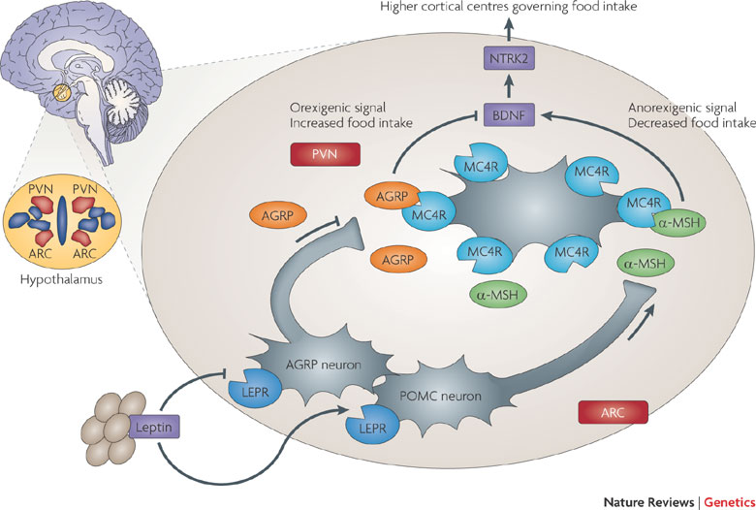
Regulation of Food Intake
Nature Reviews Genetics 10, 431-442 (July 2009)
Notes:
The central nervous system plays a primary part in regulating food intake through the brain–gut axis¹⁴³, with the hypothalamus acting as the central regulator, receiving both long- and short-term food intake and energy expenditure feedback from the periphery. Signals are received from several tissues and organs, including: the gut, by hormones, such as ghrelin, peptide YY and cholecystokinin (CCK), and by mechanoreceptors measuring distension; and the pancreas, for example, through insulin and adipose tissue, and by hormones such as leptin and adiponectin^{144, 145}. The hypothalamus integrates these signals and acts through various downstream pathways to maintain energy balance. Although this system is well suited to preventing weight loss in times of starvation, it is rather less efficient at preventing weight gain. The rise in leptin levels that accompanies increasing adiposity has only a limited effect on food intake owing to cellular resistance to leptin, which may have evolved as a mechanism of preventing starvation¹⁴⁶. The melanocortin 4 receptor (MC4R) is highly expressed in the paraventricular nucleus (PVN) of the hypothalamus, where it has a key role in the control of appetite. Leptin released from adipose tissue binds to leptin receptors (LEPR) on agouti-related protein (AGRP)-producing neurons and proopionomelanocortin (POMC)-producing neurons in the arcuate nucleus (ARC) of the hypothalamus. Leptin binding inhibits AGRP production and stimulates the production of POMC, which undergoes post-translational modification to generate a range of peptides, including -, - and -melanocyte-stimulating hormone (MSH). AGRP and -MSH compete for MC4R — AGRP binding suppresses MC4R activity and -MSH binding stimulates MC4R activity. Decreased receptor activity generates an orexigenic signal, whereas increased receptor activity generates an anorexigenic signal. Signals from MC4R govern food intake through secondary effector neurons that lead to higher cortical centres, a process that involves brain-derived neurotrophic factor (BDNF) and neurotrophic tyrosine kinase receptor type 2 (NTRK2; also known as tropomyosin-related kinase B, TRKB).

Slide 11
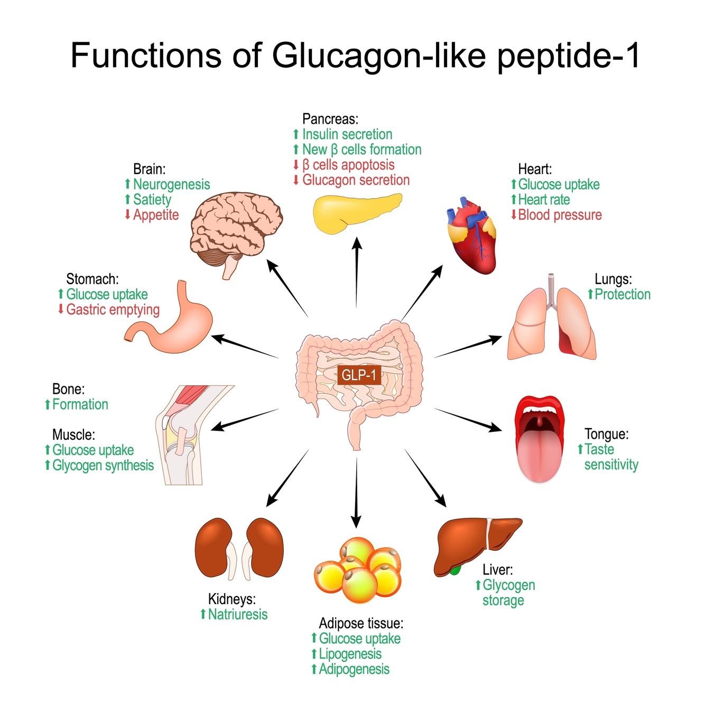
Mechanism of GLP-1 s
FATIMA CDOY STANFORD
PRESENTED BY

Slide 12








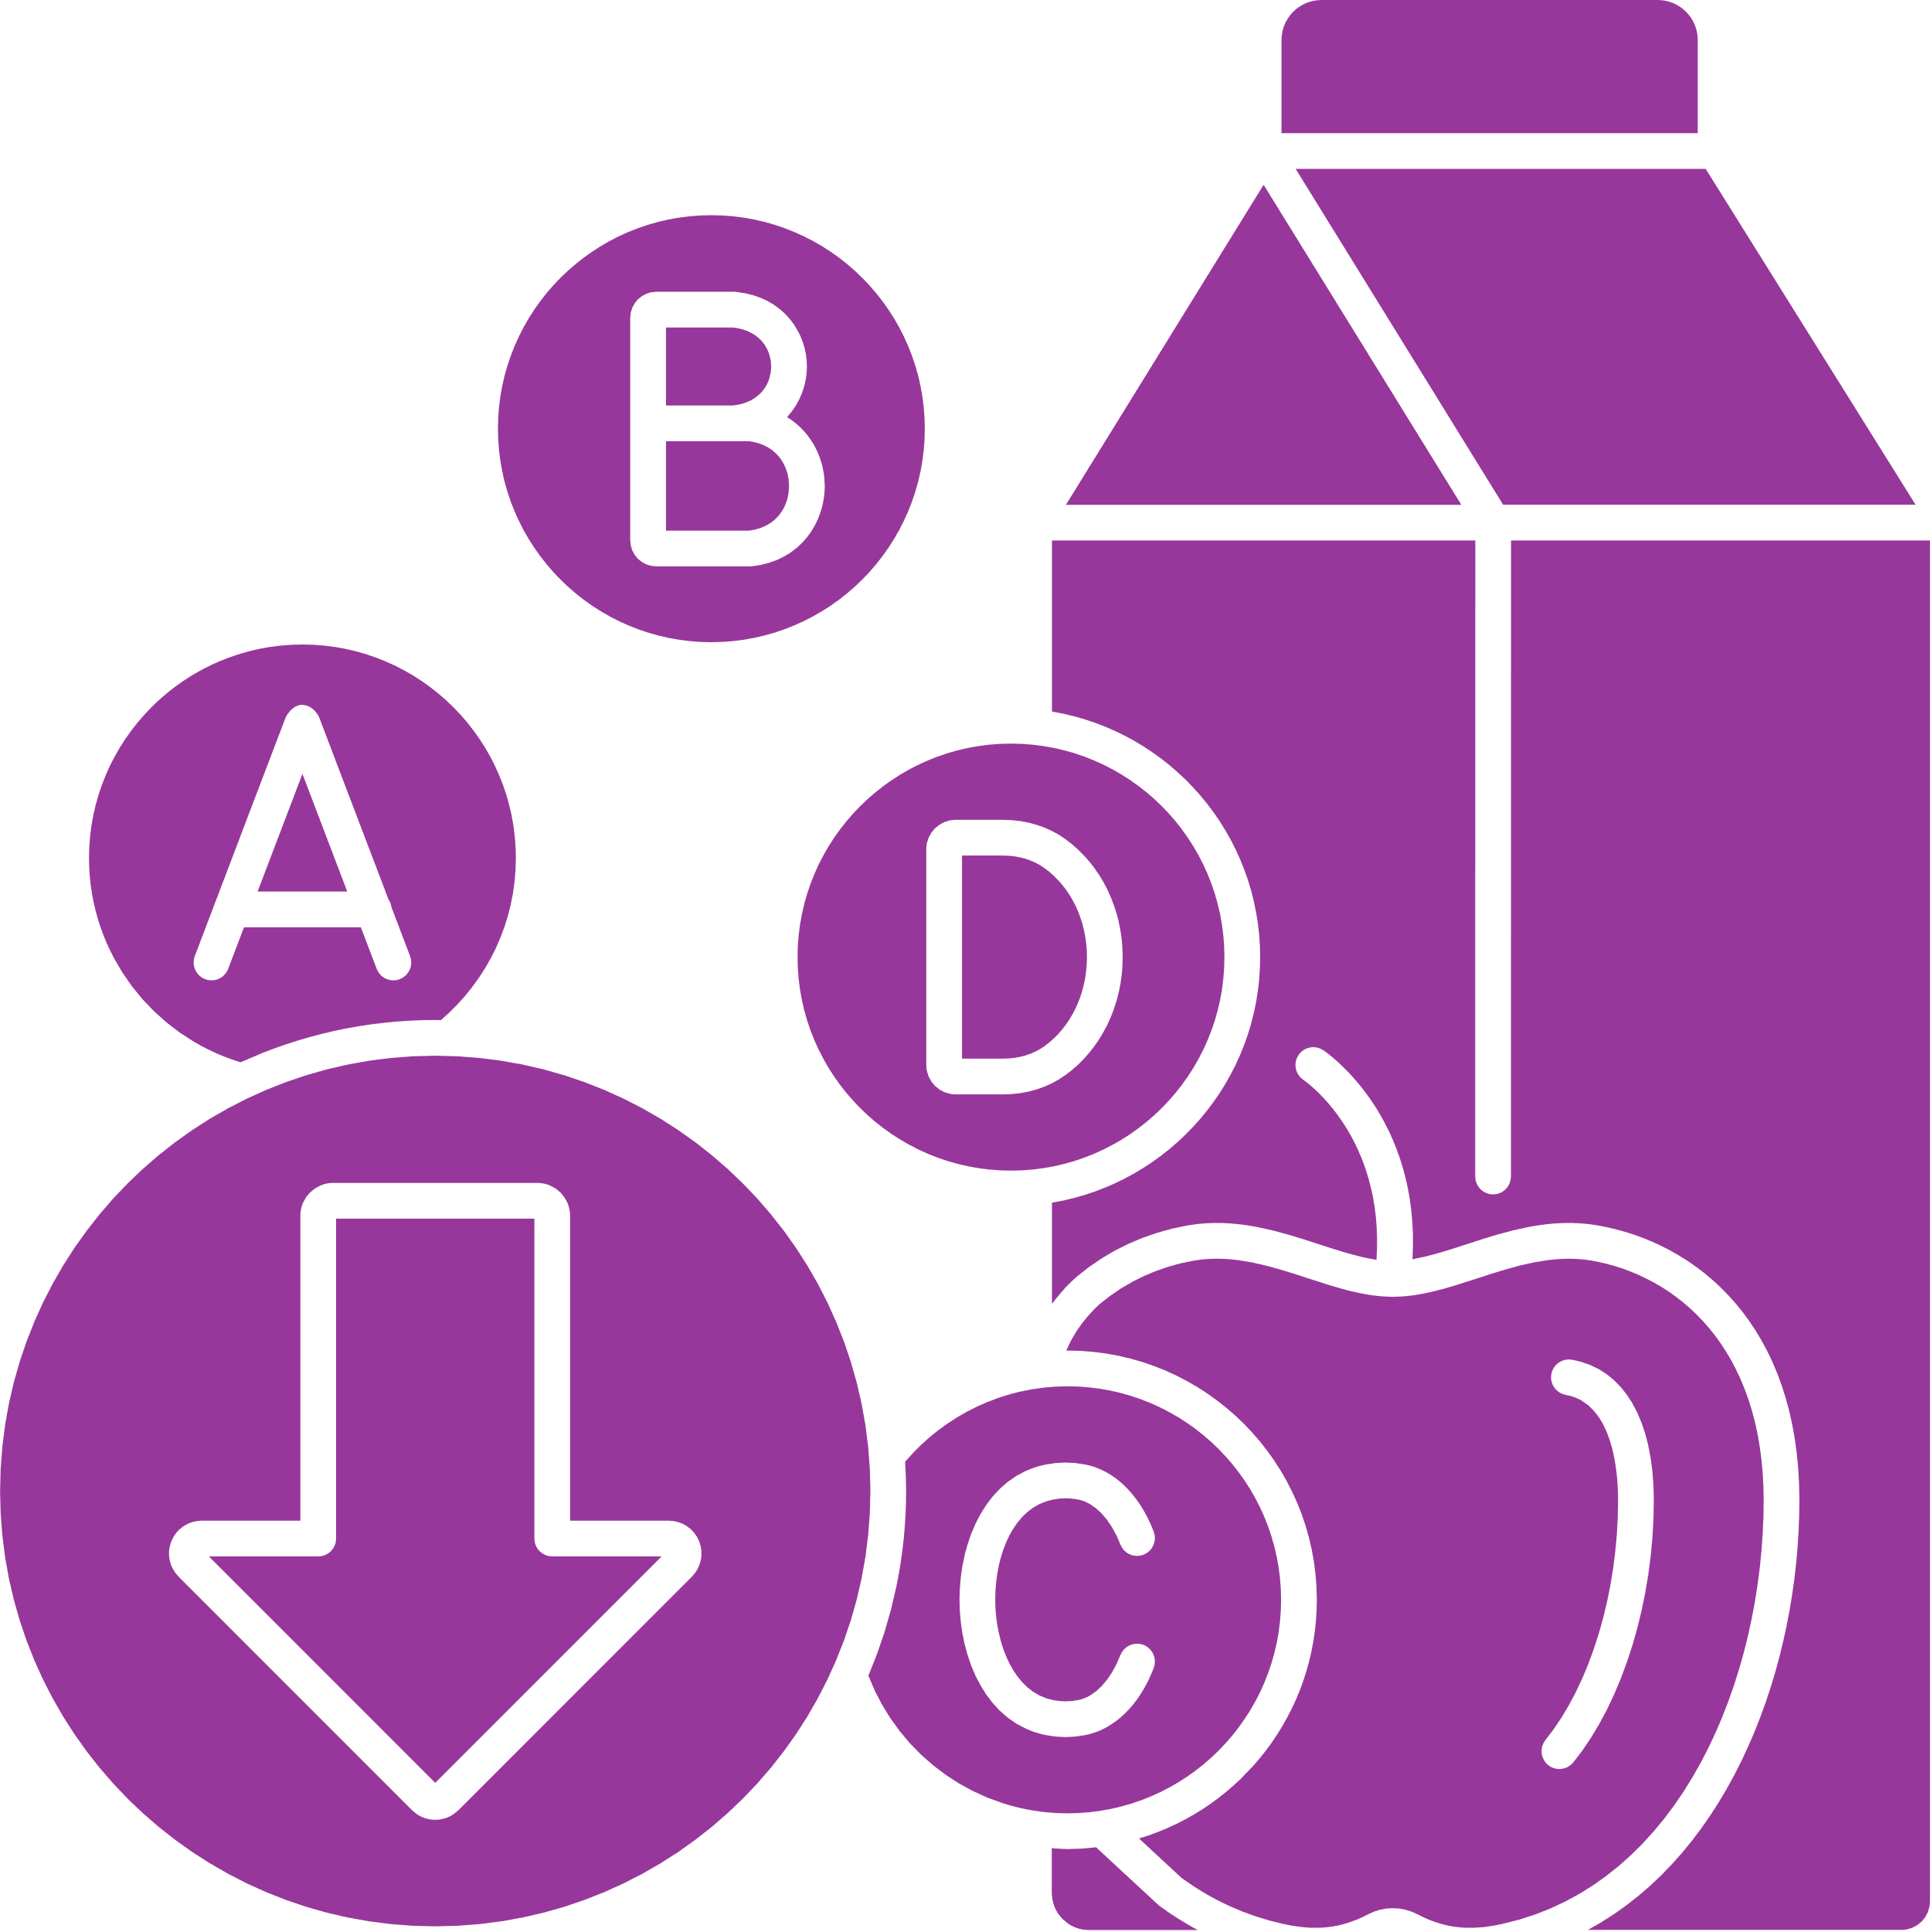


Figure 1: Key elements of nutritional priorities to support GLP-1 therapy for obesity
Completion of baseline nutritional assessment and screening
Management of gastrointestinal side effects
Initiation of GLP-1 therapy with a patient-centered approach
Nutritional Priorities to Support GLP-1 Therapy for Obesity
Navigation of dietary preferences and intakes
Promotion of other supportive lifestyle measures
Prevention and mitigation of nutrient deficiencies
Maximization of weight reduction efficacy
Preservation of muscle and bone mass
Source: Mozaffarian D, et al. Nutritional priorities to support GLP-1 therapy for obesity: a joint advisory from the American College of Lifestyle Medicine, the American Society for Nutrition, the Obesity Medicine Association, and The Obesity Society. Am J Clin Nutr. 2025; https://doi.org/10.1016/j.ajcnut.2025/04/023

Slide 13
Management of Gastrointestinal Side Effects in Obesity Treatment
Challenges and Importance
Nausea, vomiting, constipation, and diarrhea affect compliance and outcomes.
Benefits of obesity treatment often outweigh temporary GI challenges.
Proactive prevention and effective support are crucial during therapy adjustments.
Strategies for Minimizing GI Symptoms
Gradual dose escalation to minimize GI symptoms.
Allow up to 8 weeks at a GLP-1 dose during escalation.
Maintain at the lowest effective dose, escalating only as needed.
Consider medication shortages and insurance coverage limitations.
Communication and Mitigation
Clinicians should detail potential GI side effects before therapy.
Encourage early contact if side effects develop.
Provide strategies: Smaller, frequent meals; avoid fatty/high fiber foods initially.

Slide 14
Management of Gastrointestinal Side Effects in Obesity Treatment
Specific Side Effect Management
Nausea
Most common, often in the morning or after fasting.
Small, frequent meals every 3-4 hours; adequate fluids.
Ginger/peppermint tea, acupressure bands, anti-nausea meds (e.g., prochlorperazine).
Vomiting
More likely with large meals.
Prevent dehydration to avoid acute kidney injury and heart palpitations.
Constipation
Common with weight loss; manage proactively.
Encourage fluids, fiber from foods, and low-viscosity foods.
Gradually increase soluble/insoluble fiber intake.
Additional therapies: Magnesium supplementation, fiber supplements, stool softeners.
Diarrhea
Avoid large/high-fat meals; consider fiber supplements.
Use anti-diarrheal meds for acute relief.
Additional Considerations
Minimize alcohol use due to potential exacerbation of nausea and reflux with GLP-1 therapy.

Slide 15

Prevention and Mitigation of Nutrient Deficiencies in GLP-1 Therapy
Nutrient Adequacy in Lower-Calorie Diets
Emphasize diversity of nutrient-dense, minimally processed foods:
Fruits, vegetables, whole grains, legumes, lean proteins, nuts, seeds.
Avoid refined carbohydrates, sugar-sweetened beverages, red/processed meats, fast foods, and ultra-processed snacks.
Dietary Supplements
Consider supplements for at-risk nutrients (vitamin D, calcium, B12, multivitamins).
Tailor doses to individual needs.
Meal Strategies
Recommend small, frequent meals when hunger and food interest are low.
Opt for healthful smoothies, protein drinks, cottage cheese, and soups over heavier foods.
Use reminders to ensure regular eating.
Protein and Strength Training
Prioritize dietary protein to preserve muscle mass and bone density.
Combine with a structured strength training program.
Ongoing Monitoring and Adjustments
Regularly reassess dietary intake, hydration, and nutrient levels using food logs or photos.
Adjust dietary recommendations based on weight reduction rate, nutrient status, and treatment response.
PRESENTED BY
FATIMA CODY STANFORD

Slide 16
Prevention and Mitigation of Nutrient Deficiencies in GLP-1 Therapy
FATIMA CDOY SATNFORD
PRESENTED BY
Nutrient Adequacy in Lower-Calorie Diets
Emphasize diversity of nutrient-dense, minimally processed foods:
Fruits, vegetables, whole grains, legumes, lean proteins, nuts, seeds.
Avoid refined carbohydrates, sugar-sweetened beverages, red/processed meats, fast foods, and ultra-processed snacks.
Dietary Supplements
Consider supplements for at-risk nutrients (vitamin D, calcium, B12, multivitamins).
Tailor doses to individual needs.
Meal Strategies
Recommend small, frequent meals when hunger and food interest are low.
Opt for healthful smoothies, protein drinks, cottage cheese, and soups over heavier foods.
Use reminders to ensure regular eating.
Protein and Strength Training
Prioritize dietary protein to preserve muscle mass and bone density.
Combine with a structured strength training program.
Ongoing Monitoring and Adjustments
Regularly reassess dietary intake, hydration, and nutrient levels using food logs or photos.
Adjust dietary recommendations based on weight reduction rate, nutrient status, and treatment response.

Slide 17
Strategies to Preserve Muscle and Bone Mass During GLP-1 Therapy
FATIMA CDOY SATNFORD
PRESENTED BY
Importance of Muscle and Bone Preservation
Protein Intake Recommendations
General recommendation: 0.8 g/kg body weight/day; higher targets (1.2-1.6 g/kg) proposed during weight loss.
Role of Structured Exercise
Increased protein intake alone is insufficient; strength training is essential.
Weight reduction can negatively impact muscle and bone mass, leading to health issues like physical impairment, falls, and fractures.
Preservation of muscle and bone mass is crucial for maintaining physical function and quality of life.
Protein needs may be best estimated using fat-free mass; aim for 1.5 g/kg lean body mass/day.
Encourage plant proteins, dairy, seafood, eggs, lean poultry; limit red and processed meats.
Practical options: fish, eggs, Greek yogurt, cottage cheese, nuts, and seeds.
Protein supplements can aid in meeting targets.
Structured resistance and mixed training programs help preserve lean mass.
Aim for at least 3 strength sessions and 150 minutes of moderate aerobic exercise weekly

Slide 18
Monitoring and Enhancing Muscle and Bone Health
Muscle Mass Monitoring Techniques
Bioelectrical impedance analysis (BIA) is practical and cost-effective for monitoring muscle mass.
Assessing Muscle Health and Function
Muscle strength assessments: sit-to-stand, stair climb, timed-up-and-go for older adults.
Exercise Program Customization
Tailor exercise programs to individual fitness levels for adherence and effectiveness.
Emerging Technologies and Research
Air displacement plethysmography for individuals with electronic medical implants.
Dual-energy X-ray absorptiometry (DXA) is the gold standard but costly and less frequent.
One-repetition maximum not recommended unless highly trained.
Collaboration with exercise physiologists or strength trainers is beneficial for program development and monitoring.
New technologies, like visual-based capture using smartphones, are being validated.
Research on GLP-1 therapy’s effects on muscle quality and function is ongoing, providing future insights.
PRESENTED BY
FATIMA CODY STANFORD

Slide 19

Approval and Efficacy of GLP-1s
FATIMA CODY STANFORD
Liraglutide 3.0 mg (2014)
Semaglutide 2.4 mg (2021)
Effective for T2D and obesity.
Half-life: ~7 days.
It enhances hunger control and reduces food cravings.
Tirzepatide 15 mg (2022)
Most effective for T2D and obesity
Half~life: ~ 7 days
It has shown the best efficacy for enhancing hunger control, reducing food cravings, and improving glucose control.
PRESENTED BY

Slide 20
Table 1. Efficacy and outcomes at 52 weeks of GLP-1 therapy¹ in the landmark industry-sponsored randomized controlled trials
Medication | Mean intervention weight reduction | Mean placebo weight reduction | Mean placebo-adjusted GLP-1 effect | Metabolic risk and health outcomes improved | Key exclusion criteria
Liraglutide 3.0 mg/wk² | 7.9% | 2.6% | 5.3% | Glycemic control (glycated hemoglobin, fasting glucose, fasting insulin), systolic and diastolic blood pressure, cholesterol (total, LDL, HDL, VLDL, non-HDL), triglycerides, free fatty acids, health-related quality of life | Type 1 or 2 diabetes Use of medications that cause clinically significant weight gain or loss Previous bariatric surgery Personal history of pancreatitis; major depressive or other severe psychiatric disorders Personal or family history of multiple endocrine neoplasia type 2 or familial medullary thyroid carcinoma
Semaglutide 2.4 mg/wk³ | 14.9% | 2.4% | 12.4% | Waist circumference, systolic blood pressure, physical functioning scores | History of type 1 or type 2 diabetes mellitus Glycated hemoglobin ≥6.5% Personal history of chronic pancreatitis, acute pancreatitis within 180 days before enrollment Previous surgical treatment for obesity Treatment with a medication that promotes weight loss within 90 days before enrollment
Tirzepatide 5 mg/wk⁴ | 15.0% | 3.1% | 11.9% | Waist circumference, systolic and diastolic blood pressure, physical functioning scores, triglycerides, cholesterol (total, LDL, VLDL, HDL, non-HDL), free fatty acids, fasting insulin | History of type 1 or type 2 diabetes mellitus Change in body weight >5 kg within 90 days before screening Previous or planned surgical treatment for obesity Treatment with a medication that promotes weight loss within 90 days before screening
Tirzepatide 10 mg/wk⁴ | 19.5% | 3.1% | 16.4% | As above | As above
Tirzepatide 15 mg/wk⁴ | 20.9% | 3.1% | 17.8% | As above | As above
¹ Includes tirzepatide, which combines GLP-1 agonism with glucose-dependent insulinotropic polypeptide receptor agonism.
² Data from (13), primary outcomes at 56 weeks.
³ Data from (14), primary outcomes at 68 weeks.
⁴ Data from (15), primary outcomes at 72 weeks.
Source: Mozaffarian D, et al. Nutritional priorities to support GLP-1 therapy for obesity: a joint advisory from the American College of Lifestyle Medicine, the American Society for Nutrition, the Obesity Medicine Association, and The Obesity Society. Am J Clin Nutr. 2025; https://doi.org/10.1016/j.ajcnut.2025/04/023

Slide 21
Table 2. Common side effects reported in semaglutide and tirzepatide trials for obesity¹
Side effect | Semaglutide 2.4 mg group (%) | Placebo group (%) | Tirzepatide 15 mg group (%) | Placebo group (%)
Nausea | 44 | 16 | 28 | 8
Diarrhea | 30 | 16 | 23 | 8
Vomiting | 24 | 6 | 13 | 2
Constipation | 24 | 11 | 11 | 5
Abdominal pain | 20 | 10 | 10 | 5
Headache | 14 | 10 | - | -
Fatigue | 11 | 5 | 7 | 3
Dyspepsia | 9 | 3 | 10 | 4
Dizziness | 8 | 4 | 4 | 2
Abdominal distension | 7 | 5 | 4 | 2
Eructation | 7 | <1 | 5 | 1
Hypoglycemia² | 6 | 2 | - | -
Flatulence | 6 | 4 | 4 | 2
Gastroenteritis | 6 | 4 | - | -
Gastroesophageal reflux | 5 | 3 | 5 | 2
Gastritis | 4 | 1 | - | -
Hair Loss | 3 | 1 | 5 | 1
¹ Data from (42, 43), based on follow-up periods of up to 68 weeks (semaglutide)
or 72 weeks (tirzepatide).
² Among individuals with type 2 diabetes.
Source: Mozaffarian D, et al. Nutritional priorities to support GLP-1 therapy for obesity: a joint advisory from the American College of Lifestyle Medicine, the American Society for Nutrition, the Obesity Medicine Association, and The Obesity Society. Am J Clin Nutr. 2025; https://doi.org/10.1016/j.ajcnut.2025/04/023

Slide 22
Table 3. Key guidelines for lifestyle modification therapies for individuals with obesity¹
Organization | Recommendations
American Heart Association/American College of Cardiology/The Obesity Society (2013²) | Counsel adults with overweight and obesity with CVD risk factors (hypertension, hyperlipidemia, hyperglycemia) that lifestyle changes that produce even modest, sustained weight reduction of 3-5% produce clinically meaningful health benefits, and greater weight reduction produces greater benefits (Grade I-A) Prescribe a diet to achieve reduced calorie intake for weight reduction (Grade I-A) Advise/prescribe participation in a comprehensive lifestyle intervention for 6 or more months (including at least 14 sessions over 6 months) (Grade I-A)
United States Preventive Services Task Force (2018³) | Offer or refer adults with obesity to intensive, multicomponent behavioral interventions. This includes weight reduction and weight reduction maintenance interventions with components that focus on nutrition, physical activity, self-monitoring, identifying barriers, problem solving, peer support, and relapse prevention (B recommendation)
United States Preventive Services Task Force (2020⁴) | Offer or refer adults with CVD risk factors (hypertension, dyslipidemia, metabolic syndrome, or estimated 10-year CVD risk >7.5%) to behavioral counseling interventions to promote a healthy diet and physical activity (B recommendation)
¹This table presents key examples, not necessarily a complete compendium, of major lifestyle recommendations from these reports.
² Data from (94). Grade I-A is an indicator of the recommendation and its level of evidence, here denoting that the procedure or treatment should be performed/administered and has strong evidence that it is useful/effective.
³ Data from (95). B recommendation is an indicator that the USPSTF recommends the service. There is high certainty that the net benefit is moderate or there is moderate certainty that the net benefit is moderate to substantial. Suggestions for practice: Offer or provide this service.
⁴ Data from (96). An update for this topic was in progress during this manuscript’s development (100).
⁵ Data from (97).
⁶ Data from (98).
⁷ Data from (99).
Source: Mozaffarian D, et al. Nutritional priorities to support GLP-1 therapy for obesity: a joint advisory from the American College of Lifestyle Medicine, the American Society for Nutrition, the Obesity Medicine Association, and The Obesity Society. Am J Clin Nutr. 2025; https://doi.org/10.1016/j.ajcnut.2025/04/023

Slide 23
Table 3. Key guidelines for lifestyle modification therapies for individuals with obesity¹ (continued)
Organization | Recommendations
Canadian Medical Association (2020⁵) | Adults living with obesity should receive individualized care plans that address their root causes of obesity and that provide support for behavioral change (e.g., nutrition, physical activity). Adults living with obesity should receive individualized medical nutrition therapy provided by a registered dietitian (when available) to improve weight outcomes (body weight, BMI), waist circumference, glycemic control, established lipid, and blood pressure targets. (Level 1a, Grade A) Adults living with obesity can consider any of multiple medical nutrition therapies to improve health-related outcomes, choosing the dietary patterns and food-based approaches that support their best long-term adherence.
United States Preventive Services Task Force (2021⁶) | Screen adults aged 35 to 70 years who have overweight or obesity for prediabetes and diabetes; and offer or refer patients with prediabetes to effective preventive interventions, such as lifestyle interventions that focus on diet, physical activity, or both (e.g., the Diabetes Prevention Program) (B recommendation†)
European Association for the Study of Obesity (2024⁷) | Provide behavioral modifications for all persons with obesity, including nutritional therapy, physical activity, stress reduction, and sleep improvement.
¹This table presents key examples, not necessarily a complete compendium, of major lifestyle recommendations from these reports.
² Data from (94). Grade I-A is an indicator of the recommendation and its level of evidence, here denoting that the procedure or treatment should be performed/administered and has strong evidence that it is useful/effective.
³ Data from (95). B recommendation is an indicator that the USPSTF recommends the service. There is high certainty that the net benefit is moderate or there is moderate certainty that the net benefit is moderate to substantial. Suggestions for practice: Offer or provide this service.
⁴ Data from (96). An update for this topic was in progress during this manuscript’s development (100).
⁵ Data from (97).
⁶ Data from (98).
⁷ Data from (99).
Source: Mozaffarian D, et al. Nutritional priorities to support GLP-1 therapy for obesity: a joint advisory from the American College of Lifestyle Medicine, the American Society for Nutrition, the Obesity Medicine Association, and The Obesity Society. Am J Clin Nutr. 2025; https://doi.org/10.1016/j.ajcnut.2025/04/023

Slide 24
Table 4. The 5As framework¹ applied to support nutrition and lifestyle for obesity care using GLP-1 therapy
Step | Key components | Examples of topics to address
Assess | Life stage Medical history and diagnoses Physical exam, laboratory tests Food and nutrition security; dietary history and assessment Social determinants of health Psychosocial factors, e.g., mental stress, factors related to eating such as cultural and familial preferences Other potential barriers to change, e.g., food allergies or intolerances | Age of onset of problems with excess weight Periods of rapid weight gain and triggers for such exacerbations Previously attempted weight interventions (e.g., formal or informal diet or lifestyle programs, meal replacement approaches, medically monitored programs, very low-calorie diet programs, medications, weight reduction supplements, or metabolic procedures including devices and surgeries
Advise | Benefits and risks of GLP-1 assessment Essential complementary role of long-term nutrition and lifestyle change Role of nutrition and lifestyle as foundations of health, with benefits beyond weight alone, with GLP-1 as the adjunctive therapy (a re-setting of the drug-focused medical paradigm) | Nutritional and physical activity recommendations GLP-1 side effects Compliance with dosing schedule
¹ This framework can be further adapted for obesity care to begin with Ask, i.e. asking permission to discuss topics such as weight and eating patterns.
Source: Mozaffarian D, et al. Nutritional priorities to support GLP-1 therapy for obesity: a joint advisory from the American College of Lifestyle Medicine, the American Society for Nutrition, the Obesity Medicine Association, and The Obesity Society. Am J Clin Nutr. 2025; https://doi.org/10.1016/j.ajcnut.2025/04/023

Slide 25
Table 4. The 5As framework¹ applied to support nutrition and lifestyle for obesity care using GLP-1 therapy
Step | Key components | Examples of topics to address
Agree | Shared plan of care to increase likelihood that both weight reduction and general health goals are understood and expectations are appropriate | Shared decision making on target body weight, and plan for continuity of care including making appropriate follow up appointments. Culturally tailored meal plan, exercise plan, etc. Including creating S.M.A.R.T. prescriptions (Specific, Measurable, Actionable, Realistic, Time-sensitive) for eating and activity goals.
Assist | Address challenges and barriers such as food access, transportation, and need for financial resources | Eligibility assessment and enrollment support (if eligible) for federal food assistance programs such as SNAP Help find local physical activity resources such as parks, recreation centers
Arrange | Refer as needed to other specialists | Registered dietitian nutritionist Behavioral therapist Social worker Case manager
¹ This framework can be further adapted for obesity care to begin with Ask, i.e. asking permission to discuss topics such as weight and eating patterns.
Source: Mozaffarian D, et al. Nutritional priorities to support GLP-1 therapy for obesity: a joint advisory from the American College of Lifestyle Medicine, the American Society for Nutrition, the Obesity Medicine Association, and The Obesity Society. Am J Clin Nutr. 2025; https://doi.org/10.1016/j.ajcnut.2025/04/023

Slide 26
Table 5. Components and topics for medical and nutritional screening and assessment
Medical history and diagnoses
Age of onset of problems with excess weight
Periods of rapid weight gain and triggers for such exacerbations
Goals for weight reduction and general health
Patient-centered approach to consider the person’s circumstances, preferences, values, and medical conditions (see Table 4)
Source: Mozaffarian D, et al. Nutritional priorities to support GLP-1 therapy for obesity: a joint advisory from the American College of Lifestyle Medicine, the American Society for Nutrition, the Obesity Medicine Association, and The Obesity Society. Am J Clin Nutr. 2025; https://doi.org/10.1016/j.ajcnut.2025/04/023
https://doi.org/10.1016/j.ajcnut.2025/04/023

Slide 27
Table 5. Components and topics for medical and nutritional screening and assessment
Screening/assessment for conditions relevant to GLP-1 use
* Gastrointestinal symptoms or disorders
* Affective disorders/mood disorders, suicidal thoughts
* Binge eating disorder, anorexia nervosa, bulimia nervosa, and night eating disorder¹
* Sarcopenia, osteopenia
* Nephrolithiasis or renal impairment
Source: Mozaffarian D, et al. Nutritional priorities to support GLP-1 therapy for obesity: a joint advisory from the American College of Lifestyle Medicine, the American Society for Nutrition, the Obesity Medicine Association, and The Obesity Society. Am J Clin Nutr. 2025; https://doi.org/10.1016/j.ajcnut.2025/04/023
https://doi.org/10.1016/j.ajcnut.2025/04/023

Slide 28
Table 5. Components and topics for medical and nutritional screening and assessment
Physical exam
Comprehensive clinical exam
Muscle strength and function (e.g., sit-to-stand, stair climb, timed-up-and-go; consider consultation with an exercise physiologist or strength trainer)
Consider measurement of muscle mass (e.g., bioelectrical impedance analysis, air displacement plethysmography, dual-energy X-ray absorptiometry)
Source: Mozaffarian D, et al. Nutritional priorities to support GLP-1 therapy for obesity: a joint advisory from the American College of Lifestyle Medicine, the American Society for Nutrition, the Obesity Medicine Association, and The Obesity Society. Am J Clin Nutr. 2025; https://doi.org/10.1016/j.ajcnut.2025/04/023
https://doi.org/10.1016/j.ajcnut.2025/04/023

Slide 29
Table 5. Components and topics for medical and nutritional screening and assessment
Social determinants of health
Food insecurity, nutrition insecurity
Housing or transportation challenges
Other barriers to healthcare access
Source: Mozaffarian D, et al. Nutritional priorities to support GLP-1 therapy for obesity: a joint advisory from the American College of Lifestyle Medicine, the American Society for Nutrition, the Obesity Medicine Association, and The Obesity Society. Am J Clin Nutr. 2025; https://doi.org/10.1016/j.ajcnut.2025/04/023
https://doi.org/10.1016/j.ajcnut.2025/04/023

Slide 30
Table 5. Components and topics for medical and nutritional screening and assessment
Diet history and related assessments (could be conducted by a registered dietitian nutritionist)
Current dietary habits (e.g., meal/snack patterns, intake of food groups, fast foods and processed foods, cultural and household preferences)
Emotional triggers for off-plan, loss of control, or late-night eating
Food allergies, intolerances, sensitivities
Conditions that may influence nutrition needs (e.g., smoking, history of kidney stones, use of certain medications)
Previously attempted weight interventions (e.g., diet or lifestyle approaches or interventions, medications, or metabolic procedures including devices and surgeries) ²
Source: Mozaffarian D, et al. Nutritional priorities to support GLP-1 therapy for obesity: a joint advisory from the American College of Lifestyle Medicine, the American Society for Nutrition, the Obesity Medicine Association, and The Obesity Society. Am J Clin Nutr. 2025; https://doi.org/10.1016/j.ajcnut.2025/04/023
https://doi.org/10.1016/j.ajcnut.2025/04/023

Slide 31
Table 5. Components and topics for medical and nutritional screening and assessment
Lifestyle behaviors
Physical activity including resistance training, with referral to exercise physiologist or physical therapy where appropriate
Sleep habits, with referral to sleep specialist where appropriate
Mental stress management, with referral for cognitive-behavioral therapy or mindfulness-based stress reduction where appropriate
Substance use, with referral for cessation or counseling services where appropriate
Social connections, consider group medical visits, shared medical appointments, weight management or peer-support groups, and addressing barriers to social engagement
Source: Mozaffarian D, et al. Nutritional priorities to support GLP-1 therapy for obesity: a joint advisory from the American College of Lifestyle Medicine, the American Society for Nutrition, the Obesity Medicine Association, and The Obesity Society. Am J Clin Nutr. 2025; https://doi.org/10.1016/j.ajcnut.2025/04/023
https://doi.org/10.1016/j.ajcnut.2025/04/023

Slide 32
Table 6. Key dietary recommendations to support effective GLP-1 therapy¹
Factors to encourage | Factors to minimize/avoid
Food groups Fruits (e.g., berries, apples, citrus fruits, banana, grapes, avocado) Vegetables (e.g., broccoli, leafy greens, tomatoes, carrots, peas, squashes) Whole grains (e.g., oats, quinoa, brown rice, and whole-grain breads, cereals, and pastas) Dairy (e.g., yogurt, milk, cheese) Nuts and seeds (e.g., almonds, peanuts, chia seeds, sesame seeds, hemp seeds) Plant fats/oils (e.g., olive, canola, avocado oils) Ginger or peppermint tea | Refined carbohydrates (processed grains, flours, added sugars) Sugar-sweetened beverages Red and processed meats Most fast foods Sweets and savory snacks
Eating habits² Regular, small meals at consistent times Flexibility with food choices Enjoy portion-controlled treats Ensure adequate fluids Minimal alcohol intake | Emotional, mindless, or nighttime eating Long periods without meals (i.e., becoming overly hungry) Consumption of large meals
¹ Nutritional recommendations and counseling are important to support weight reduction, prevent and mitigate gastrointestinal side effects, reduce muscle and bone loss, and support long-term weight maintenance.
² A registered dietitian nutritionist can help determine a dietary pattern that meets nutrition goals while accommodating an individual’s dietary needs and preferences. Additional behaviors generally associated with long-term weight maintenance include regular physical activity (60+ minutes/day); self-monitoring of body weight, food intake, and activity; limiting screen time (<10 hours/week); and use of coping strategies including social support, advance planning, and problem-solving skills.
Source: Mozaffarian D, et al. Nutritional priorities to support GLP-1 therapy for obesity: a joint advisory from the American College of Lifestyle Medicine, the American Society for Nutrition, the Obesity Medicine Association, and The Obesity Society. Am J Clin Nutr. 2025; https://doi.org/10.1016/j.ajcnut.2025/04/023
Source: Mozaffarian D, et al. Nutritional priorities to support GLP-1 therapy for obesity: a joint advisory from the American College of Lifestyle Medicine, the American Society for Nutrition, the Obesity Medicine Association, and The Obesity Society. Am J Clin Nutr. 2025; https://doi.org/10.1016/j.ajcnut.2025/04/023

Slide 33
Table 7. Telehealth and digital platform support for nutrition during GLP-1 treatment
Video Visits
Synchronous video visits with physicians, other practitioners, registered dietitian nutritionists (RDNs), exercise physiologists, and clinical psychologists can support both initial evaluation and for ongoing follow-up.
Such visits can improve adherence and motivation; identify, address, and provide timely feedback to manage side effects; adjust therapy including medication and goals of care; determine when in-person visits are indicated for testing or other evaluation; and increase appointment attendance rates and patient engagement.
Abbreviations: AI, artificial intelligence; RDN, registered dietitian nutritionist; SMART; specific, measurable, achievable, realistic, timely
Source: Mozaffarian D, et al. Nutritional priorities to support GLP-1 therapy for obesity: a joint advisory from the American College of Lifestyle Medicine, the American Society for Nutrition, the Obesity Medicine Association, and The Obesity Society. Am J Clin Nutr. 2025; https://doi.org/10.1016/j.ajcnut.2025/04/023

Slide 34
Table 7. Telehealth and digital platform support for nutrition during GLP-1 treatment
Remote Patient Monitoring
Offer or refer adults with obesity to intensive, multicomponent behavioral interventions. This includes weight reduction and weight reduction maintenance interventions with components that focus on nutrition, physical activity, self-monitoring, identifying barriers, problem solving, peer support, and relapse prevention (B recommendation)
Abbreviations: AI, artificial intelligence; RDN, registered dietitian nutritionist; SMART; specific, measurable, achievable, realistic, timely
Source: Mozaffarian D, et al. Nutritional priorities to support GLP-1 therapy for obesity: a joint advisory from the American College of Lifestyle Medicine, the American Society for Nutrition, the Obesity Medicine Association, and The Obesity Society. Am J Clin Nutr. 2025; https://doi.org/10.1016/j.ajcnut.2025/04/023

Slide 35
Table 7. Telehealth and digital platform support for nutrition during GLP-1 treatment
Dietary Guidance and Tracking
Dietary-tracking apps can help primary care, specialty obesity care, and telehealth medical groups and platforms monitor nutritional habits against individualized nutritional goals.
Specialized features such as automated nutrient deficiency alerts, AI-powered meal recommendations, and integration with wearables can help identify nutritional gaps in real time.
Abbreviations: AI, artificial intelligence; RDN, registered dietitian nutritionist; SMART; specific, measurable, achievable, realistic, timely
Source: Mozaffarian D, et al. Nutritional priorities to support GLP-1 therapy for obesity: a joint advisory from the American College of Lifestyle Medicine, the American Society for Nutrition, the Obesity Medicine Association, and The Obesity Society. Am J Clin Nutr. 2025; https://doi.org/10.1016/j.ajcnut.2025/04/023

Slide 36
Table 7. Telehealth and digital platform support for nutrition during GLP-1 treatment
Education and Behavioral Support
Virtual education modules and coaching sessions can teach individuals how to incorporate minimally processed, nutrient-dense foods, manage gastrointestinal side effects, and implement sustainable dietary habits.
These can further reinforce SMART (specific, measurable, achievable, realistic, timely) goals to ensure optimized nutrient therapy, physical activity, and behavioral modification alongside medical monitoring.
Modules and coaching can be both synchronous and asynchronous, increasing flexibility for both clinicians and patients.
Abbreviations: AI, artificial intelligence; RDN, registered dietitian nutritionist; SMART; specific, measurable, achievable, realistic, timely
Source: Mozaffarian D, et al. Nutritional priorities to support GLP-1 therapy for obesity: a joint advisory from the American College of Lifestyle Medicine, the American Society for Nutrition, the Obesity Medicine Association, and The Obesity Society. Am J Clin Nutr. 2025; https://doi.org/10.1016/j.ajcnut.2025/04/023

Slide 37
Table 7. Telehealth and digital platform support for nutrition during GLP-1 treatment
Equity and Accessibility
Telehealth and digital platforms reduce geographic and other logistical barriers to quality care, for example for individuals who live in rural or underserved areas or have limited time, physical mobility, or transportation, which can reduce health disparities.
Abbreviations: AI, artificial intelligence; RDN, registered dietitian nutritionist; SMART; specific, measurable, achievable, realistic, timely
Source: Mozaffarian D, et al. Nutritional priorities to support GLP-1 therapy for obesity: a joint advisory from the American College of Lifestyle Medicine, the American Society for Nutrition, the Obesity Medicine Association, and The Obesity Society. Am J Clin Nutr. 2025; https://doi.org/10.1016/j.ajcnut.2025/04/023

Slide 38




Fatima Cody Stanford
PRESENTED BY
conclusions
Recommendations
GLP-1s are a useful tool in the treatment of obesity.
Nutritional support can be optimized to improve patient outcomes and mitigate side effects.
Close patient follow-up is needed to promote high-level care.

Slide 39





thank you
FATIMA CODY STANFORD
PRESENTED BY
PRESENTED BY
FATIMA CODY STANFORD, MD, MPH, MPA, MBA, MACP, FAAP, FAHA, FAMWA, FTOS
@askdrfatima

