Slide 1
Understanding and Using the New
﻿2020-2025 Dietary Guidelines for Americans
Webinar 1: A Behind the Scenes Look at the Development of the 2020-2025 Dietary Guidelines for Americans
Notes:
Welcome to this three-part webinar series brought to you by the American Society of Nutrition Foundation on the new Dietary Guidelines. Today’s presentations will focus on the process behind the development of the 2020-2025 Dietary Guidelines for Americans. On Feb 10th, the second session will address how gaps in knowledge revealed during development of the 2020-2025 Guidelines can be used to inform future research priorities. The final webinar will be held March 10th and will consider how to design, implement and present research for the next DGA review in 2025.
As you may know, the Dietary Guidelines are updated every 5 years. The latest edition was just released December 29th, 2020. They are used to inform nutrition education materials and programs throughout USDA and HHS agencies such as FNS, CDC, NIH and FDA. For example, they provide guidance for:
-School nutrition programs at FNS;
-Nutrition programs at FDA, such as the Nutrition Facts Panel;
-Nutrition research at NIH and USDA;
-Public health programs at CDC; as well as
-Federal Foodservice guidelines
The primary goals of this webinar series are to provide more transparency about the process used to develop the guidelines and to identify ways you can impact future recommendations.

Slide 2
Speakers
Moderator
Janet M. de Jesus, MS, RD
HHS Administrative Lead for 2020 DGAC
Nutrition Advisor, Division of Prevention Science
Office of Disease Prevention and Health Promotion
Office of the Assistant Secretary for Health, HHS
Barbara Schneeman, PhD
Chair, 2020 DGAC
Professor Emerita, University of California, Davis
Eve Essery Stoody, PhD
Designated Federal Officer and Co-Executive Secretary for 2020 DGAC
Director, Office of Nutrition Guidance & Analysis
Center for Nutrition Policy and Promotion
Food and Nutrition Service, USDA
Richard Mattes, PhD, RD
Past President, ASN
Member, 2020 DGAC
Distinguished Professor, Purdue University
Notes:
We have three outstanding presenters today.
Barbara Schneeman served as a Chair of the 2020 DGAC. She is a Professor Emerita at the University of California, Davis.
Eve Essery Stoody was the designated Federal Officer and Co-Executive Secretary for the 2020 DGAC. She is the Director of the Office of Nutrition Guidance & Analysis at the Center for Nutrition Policy and Promotion in the USDA Food and Nutrition Service
and
Janet M. de Jesus, was the HHS Administrative Lead for the 2020 DGAC. She is a Nutrition Advisor in the Division of Prevention Science, in the Office of Disease Prevention and Health Promotion and Office of the Assistant Secretary for Health.
I am Rick Mattes. I was a member of the 2020 DGAC, am past president of ASN and a Professor at Purdue University. It will be my please to moderate this session.

Slide 3
Disclosures
AFFILIATION/FINANCIAL INTERESTS (prior 12 months) | ENTITIES
Grants/Research Support | Almond Board of California; Welch’s; Gelesis
Scientific Advisory Board/Consultant/Board of Directors | Grain Foods Foundation; Mars, Inc.
Speakers Bureau | None
Stock Shareholder | None
Employee | Purdue University
Other | None

Slide 4
Learning Objectives
At the end of this program, attendees will be able to:
Discuss the procedures for establishing the Dietary Guidelines Advisory Committee (DGAC) and the charter governing the Committee’s work
Describe the three methods used by the DGAC to evaluate the scientific evidence
Summarize the process for developing, reviewing, and translating the Dietary Guidelines
Notes:
The Learning Objectives for today are to provide you with insights that will allow you to:
Discuss the procedures for establishing the Dietary Guidelines Advisory Committee (DGAC) and the charter governing the Committee’s work
Describe the three methods used by the DGAC to evaluate the scientific evidence and
Summarize the process for developing, reviewing, and translating the Dietary Guidelines

Slide 5
CPE Credit
ASN designates this educational activity for a maximum of 1 CPEUs. Dietitians and Dietetic Technicians, Registered should only claim credit commensurate with the extent of their participation in the activity.
To claim credit, please take the post webinar evaluation provided after the webinar.
Notes:
For those interested in obtaining continuing education credit for attending this webinar, ASN has designated this educational activity for a maximum of 1 CPEU.
Dietitians and Dietetic Technicians, Registered should only claim credit commensurate with the extent of their participation in the activity.
To claim credit, please take the post webinar evaluation provided after the webinar.

Slide 6
Asking Questions
Please use the “questions” box on your “Go To Meetings” screen to submit questions to our presenters.
Please submit your questions at any time during today’s webinar.
Notes:
We will allow each of the speakers to complete their presentations and then move to a question and answer period. To submit questions, please use the “questions” box on your “Go To Meetings” screen. You can submit your questions at any time during today’s webinar.
So, with that, let’s move to our first presenter, Janet De Jesus.

Slide 7

Establishing the 2020
Dietary Guidelines
Advisory Committee
Janet de Jesus, MS, RD

Slide 8
Disclosures
AFFILIATION/FINANCIAL INTERESTS (prior 12 months) | ENTITIES
Grants/Research Support | None
Scientific Advisory Board/Consultant/Board of Directors | None
Speakers Bureau | None
Stock Shareholder | None
Employee | None
Other | None

Slide 9
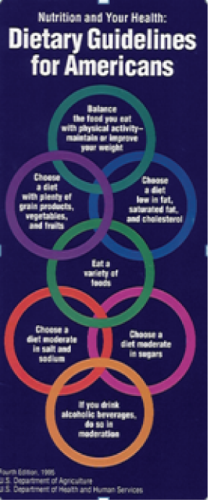
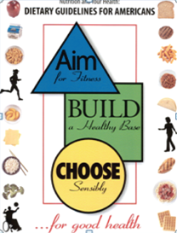
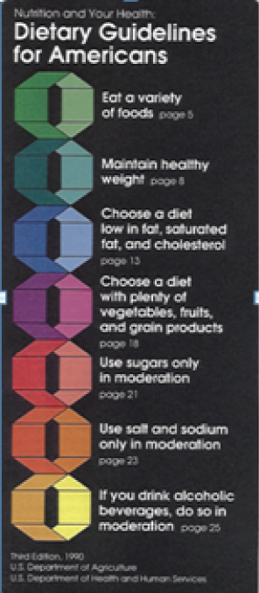
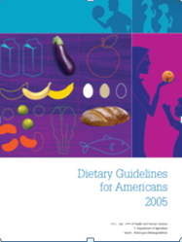
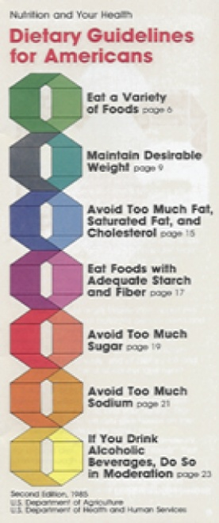

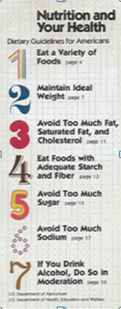
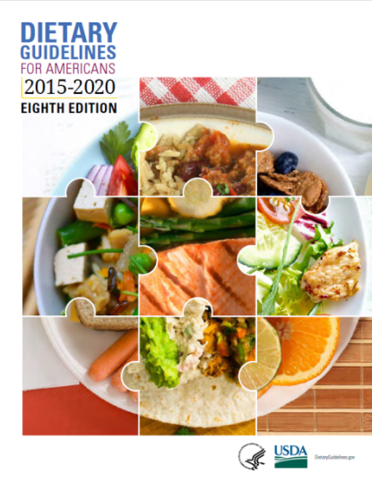

Background: Dietary Guidelines
Cornerstone of federal nutrition programs and policies, providing food-based recommendations to help prevent diet-related chronic diseases and promote overall health.
Mandated to reflect the preponderance of scientific evidence and published jointly by USDA and HHS every five years.
  National Nutrition Monitoring and Related Research Act (1990)
Targeted to professionals who work with the general public and establish policies and services to support these efforts.

Slide 10

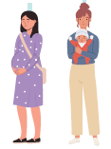
Background: Dietary Guidelines
Historically, the Dietary Guidelines has focused on 2 years of age and older. The new edition includes guidance for infants and toddlers and women who are pregnant or lactating.
Agricultural Act of 2014: Mandates the inclusion of infants and toddlers and women who are pregnant, beginning with the 2020- 2025 Dietary Guidelines for Americans.

Slide 11
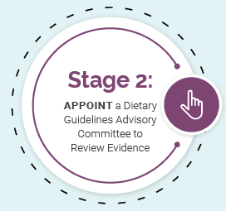
Steps for Establishing the Dietary Guidelines Advisory Committee
USDA and HHS post topics and questions to inform expertise needed on the Committee
Solicit nominations for the Committee from the public for 30 days
Committee members selected based on criteria defined in the charter
USDA and HHS Secretaries jointly agree to appoint Committee

Slide 12
Committee Charter
Describes the Advisory Committee’s purpose, duties, and general operations:
Examine the evidence on specific topics and scientific questions identified by the USDA & HHS
Develop a report that outlines its science-based review and recommendations to the USDA & HHS with rationale
Submit report to the USDA & HHS Secretaries for consideration during development of the Dietary Guidelines for Americans, 2020-2025
1
2
3

Slide 13
Dietary Guidelines Advisory Committee
Applicants completed a Confidential Financial Disclosure Report and reviewed by USDA Office of Ethics prior to being appointed
Formed and governed under the Federal Advisory Committee Act (FACA)
  Formal processes for establishing, operating, overseeing, and terminating Federal advisory committees
  Members of the Committee are appointed as “special government employees” (SGEs)
Committee members received ethics training annually

Slide 14
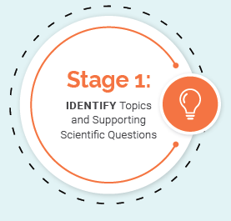
Determination of Expertise Needed
Based on topics and questions identified with Federal agency and public input:
  Dietary and beverage patterns
  Added sugars
  Dietary fats
  Seafood
  Frequency of eating
  Focus on birth to 24 months and pregnancy and lactation

Slide 15



2020 Advisory Committee Criteria
Educational background
advanced degree in nutrition or health related field
Professional experience
at least 10 years of experience as an academic, researcher, practitioner, or other health professional in a field related to topics/questions; leadership experience and participation on previous committees or panels
Demonstrated scientific expertise
expertise related to one or more of the topics to be examined

Slide 16
2020 Advisory Committee Criteria continued
Obligations under the Federal Advisory Committee Act: ensuring the Committee is balanced fairly in points of view and types of expertise
Requirements regarding a balanced membership: including, to the extent possible, individuals who are minorities, women, persons with disabilities, and representatives from different geographic areas and institutions

Slide 17







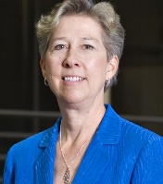












2020 Dietary Guidelines Advisory Committee
2020 Dietary Guidelines Advisory Committee
About the Dietary
Guidelines for Americans
Importance of the Dietary
Guidelines for Americans
About the Dietary
Guidelines for Americans
Barbara Schneeman, PhD
University of California-Davis
Chair
Ronald Kleinman, MD*
Harvard Medical School
Vice Chair
Jamy Ard, MD
Wake Forest School of Medicine
Regan Bailey, PhD, MPH, RD
Purdue University
Lydia Bazzano, MD, PhD
Tulane University
Carol Boushey, PhD, MPH, RD
University of Hawaii
Teresa Davis, PhD
Baylor College of Medicine
Kathryn Dewey, PhD
University of California-Davis
Sharon Donovan, PhD, RD
University of Illinois
Steven Heymsfield, MD
Louisiana State University
Heather Leidy, PhD
University of Texas
Richard Mattes, PhD, MPH, RD
Purdue University
Elizabeth Mayer-Davis, PhD, RD
University of North Carolina
Timothy Naimi, MD, MPH
Boston University
Rachel Novotny, PhD, RDN, LD
University of Hawaii
Joan Sabaté, DrPH, MD
Loma Linda University
Linda Snetselaar, PhD, RD
University of Iowa
Jamie Stang, PhD, MPH, RDN
University of Minnesota
Elsie Taveras, MD, MPH* Harvard University
Linda Van Horn, PhD, RDN, LD
Northwestern University
*Massachusetts General Hospital

Slide 18
2020 Dietary Guidelines Advisory Committee Timeline

Slide 19

Advisory Committee Analysis of the Scientific Evidence
Barbara Schneeman, PhD

Slide 20
Disclosures
AFFILIATION/FINANCIAL INTERESTS (prior 12 months) | ENTITIES
Grants/Research Support | None
Scientific Advisory Board/Consultant/Board of Directors | McCormick Science Institute International Food Information Council Board of Trustees
Speakers Bureau | None
Stock Shareholder | Mutual funds or managed accounts
Employee | N/A retired from UC Davis and Federal government
Other | 2020 Dietary Guidelines Advisory committee, chair WHO NUGAG Diet and Health subcommittee WHO NUGAG Policy Actions subcommittee NASEM: Food and Nutrition Board

Slide 21
Main Questions
How did the Dietary Guidelines Advisory Committee examine scientific evidence for the topics it was asked to address?
Did the Advisory Committee identify gaps in the evidence for these topics?

Slide 22
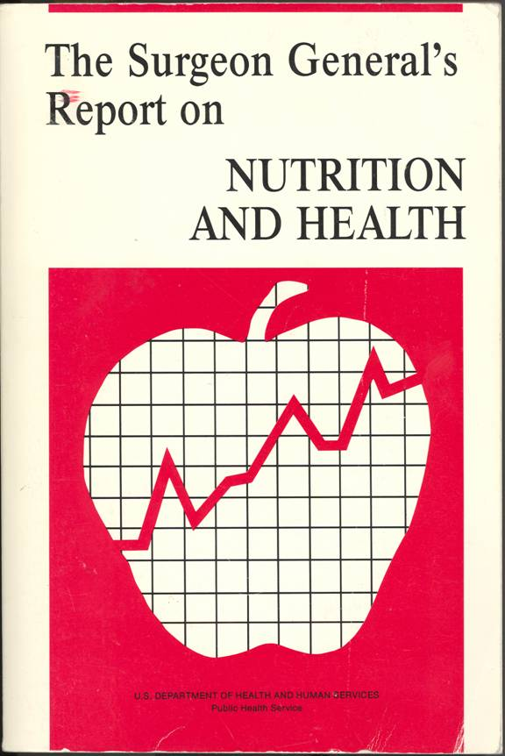
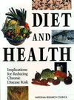

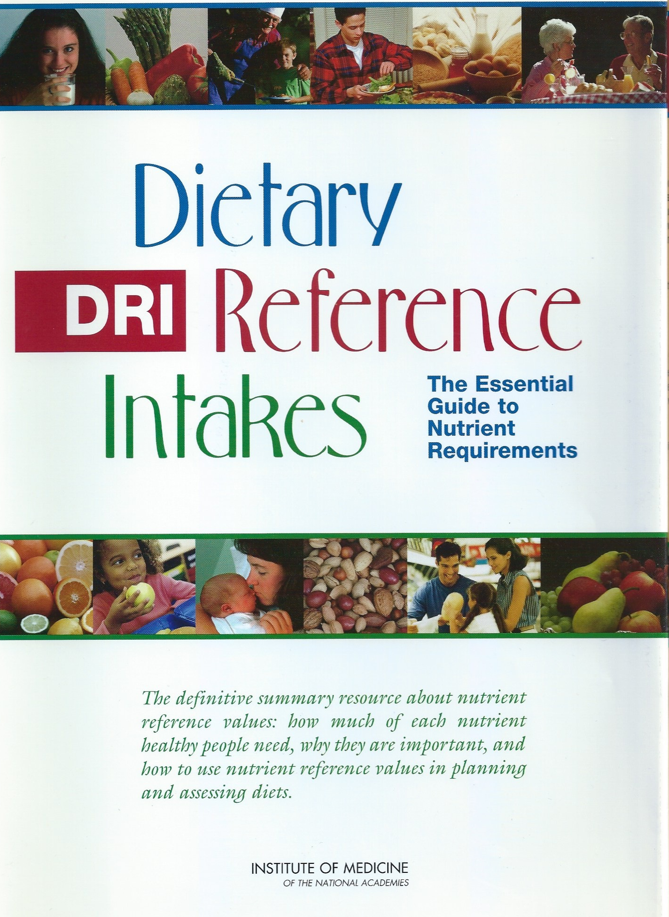
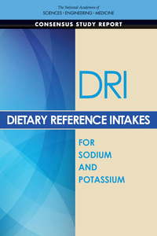

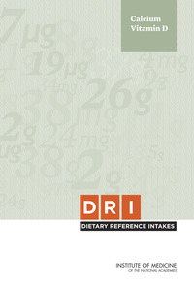

Background: Resources for the Dietary Guidelines Advisory Committees
+1990-2000
+2005-present
+2010 to present
+2017+

Slide 23
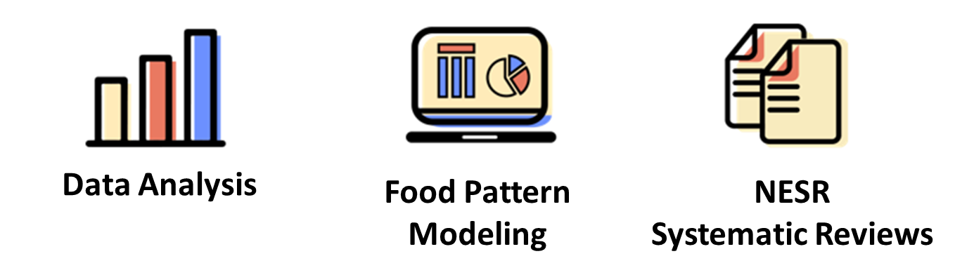
Approaches to Examine the Evidence
The Committee answered questions on diet and health using one of three approaches.
Each of these approaches has its own rigorous, protocol-driven methodology, and plays a unique, complementary role in examining the science.

Slide 24
The Committee’s Scientific Review
Data Analysis
More than 150 analyses of Federal data sets
Food Pattern Modeling
Several analyses across the life span – and representing, for the first time, 6- to 24-month life stage
NESR Systematic Review
More than 270,000 citations screened and nearly 1,500 original research articles included in 33 original systematic reviews

Slide 25
From Conclusion Statements to Advice
The Committee looked across all of the conclusion statements – the totality of our scientific review – to develop overarching advice for USDA and HHS to consider as the Departments develop the 2020-2025 Dietary Guidelines

Slide 26

Examining the Evidence: Data Analysis
Data analysis can be used to examine
Dietary patterns
Intakes of food groups and nutrients
Nutrients and food components of public health concern
Prevalence of diet-related chronic health conditions
Federal data sets
National Health and Nutrition Examination Survey (NHANES)
NHANES, What We Eat in America
  USDA Food and Nutrient Database for Dietary Studies (FNDDS)
  USDA Food Pattern Equivalents Database (FPED)
National Health Interview Survey (NHIS)
Surveillance, Epidemiology and End Results (SEER)

Slide 27
About the Dietary
Guidelines for Americans
About the Dietary
Guidelines for Americans
About the Dietary
Guidelines for Americans
Importance of the Dietary
Guidelines for Americans
Example of Results from Data Analysis Findings:
Current Intakes (Chapter 1)
About the Dietary
Guidelines for Americans
Importance of the Dietary
Guidelines for Americans
Importance of the Dietary
Guidelines for Americans
American dietary landscape has not changed appreciably over time.
Across the lifespan, the typical diet Americans consume result in overconsumption of total energy, saturated fats, sodium, added sugars, and for some consumers, alcoholic beverages.
Intakes of fruits, vegetables, and whole grains are lower than current recommendations.
Americans 1 years and older
Underconsumption of vitamin D, calcium, dietary fiber, and potassium.

Slide 28
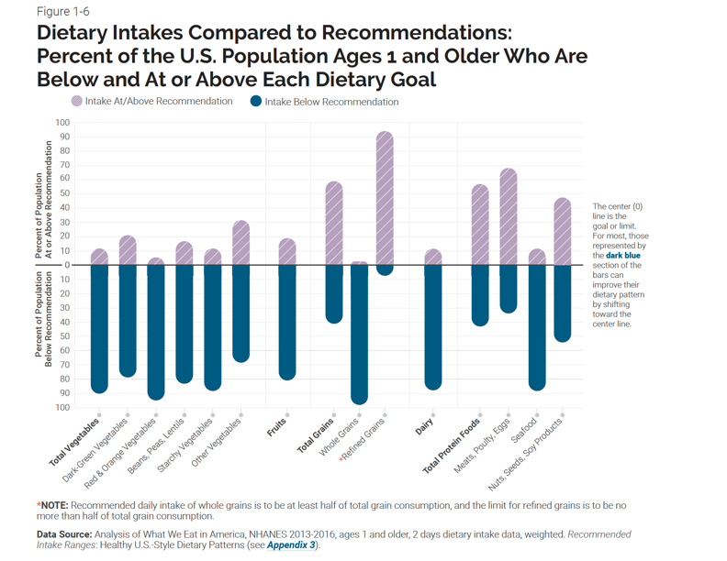

Slide 29
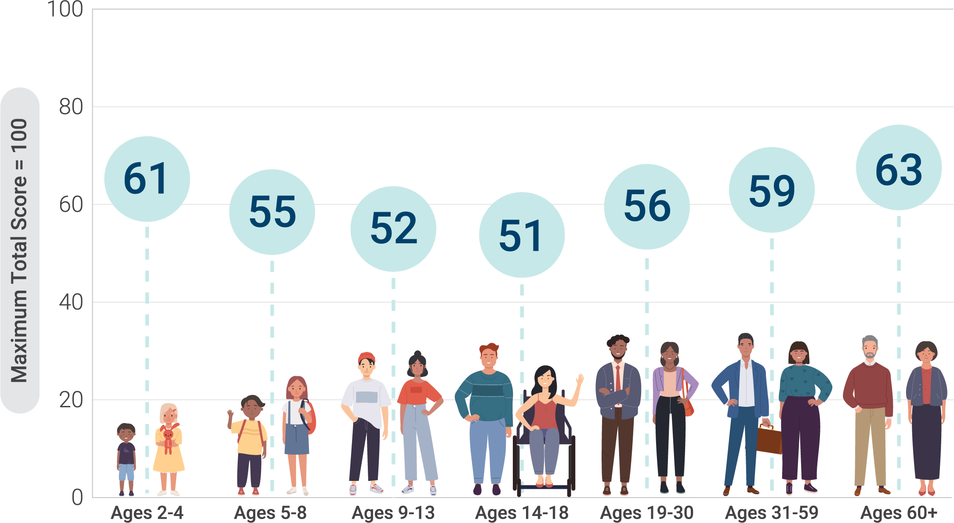
Most Americans Do Not Follow the
Dietary Guidelines
Note: HEI-2015 total scores are out of 100 possible points. A score of 100 indicates that recommendations on average were met or exceeded. A higher total score indicates a higher quality diet.
Data Source: Analysis of What We Eat in America, NHANES 2015-2016, ages 2 and older, day 1 dietary intake data, weighted.

Slide 30

Examining the Evidence: Food Pattern Modeling
Steps for updating and developing patterns established by USDA for FPM
Identify energy levels
1000 kcals
3200 kcals
Nutritional goals for each level
For each calorie level determine the nutrient goals (macros, minerals, vitamins, etc.)
Food groupings
Fruit
Vegetables
Etc
Nutrients & food components obtained
Calculate nutrients & food components obtained from each food group (kcals, macros, minerals, vitamins, etc.)
Nutrient levels vs goals
Compare nutrient levels in each pattern to established nutrient goals

Slide 31
Food Pattern Modifiable Elements
Food Group Amounts
Inclusion or Exclusion of Certain Foods
Goals and Constraints
Food Group Nutrient Profiles

Slide 32
About the Dietary
Guidelines for Americans
About the Dietary
Guidelines for Americans
About the Dietary
Guidelines for Americans
Importance of the Dietary
Guidelines for Americans
About the Dietary
Guidelines for Americans
Importance of the Dietary
Guidelines for Americans
Importance of the Dietary
Guidelines for Americans
Example of Findings from Food Pattern Modeling Committee Evidence:
Added Sugars (Chapter 12)
Question 3. How much added sugars can be accommodated in a healthy diet while still meeting food group and nutrient needs?

Slide 33
Using Modeling to Estimate Food Patterns
Total calories per day
Most energy is needed to consume foods that provide needed
nutrients and food groups
15
85%
of calories are needed per day to meet food group recommendations in nutrient dense forms
15%
Remaining calories
for other food
components
e.g., saturated fats,
added sugars, alcohol
In addition, systematic reviews
of original research papers were used for advice on saturated fats, added sugars, and alcohol.

Slide 34

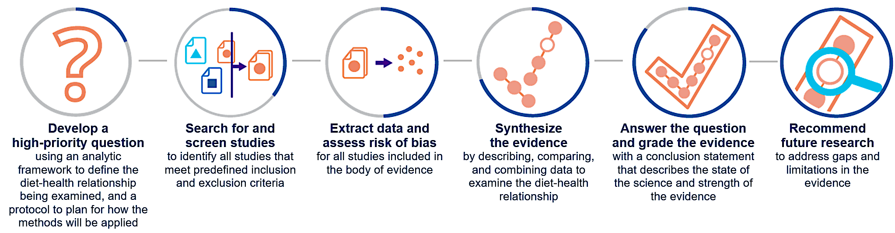
NESR Systematic Review Methodology
NESR Systematic Review
Research project that answers a question on diet and health by searching for, evaluating, and synthesizing all relevant, peer-reviewed studies.
Information available at the NESR website: https://nesr.usda.gov

Slide 35

Examining the Evidence: NESR Systematic Reviews
The systematic review criteria, analytical protocols, and draft conclusions were made available at www.dietaryguidelines.gov
Conclusions based on the systematic review are graded based on risk of bias, consistency, directness, precision, generalizability
  Evidence grades: strong, moderate, limited, or not assignable
Draft systematic reviews were peer reviewed before posted at www.dietaryguidelines.gov
Tune into the last webinar in this series which focuses on the above: Wednesday, March 10th from 1 – 2 PM EST

Slide 36
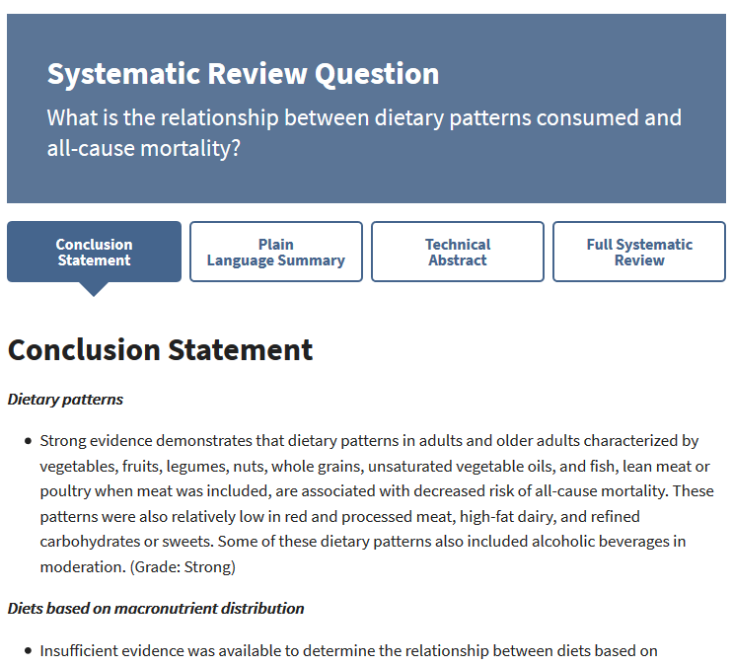
The 2020 Advisory Committee’s systematic reviews are at NESR.usda.gov
Want a snapshot of a NESR systematic review?
Plain language summary and technical abstracts available
Want full documentation of a NESR systematic review?
Full systematic review can be downloaded
Conclusion statement and grade, summary of the evidence
Description and synthesis of the evidence
Research recommendations
Methodology
  Analytic framework
  Inclusion and exclusion criteria
  Literature search strategy
  Included and excluded articles

Slide 37
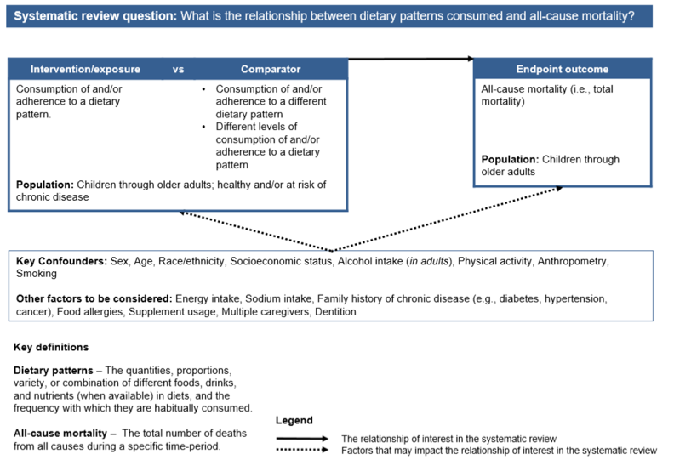
Analytic framework for SR question:
What is the relationship between dietary patterns consumed and all-cause mortality?

Slide 38
Example of Findings from Systematic Reviews
Committee Findings: Dietary Patterns (Chapter 8, p 39-40)
About the Dietary
Guidelines for Americans
About the Dietary
Guidelines for Americans
About the Dietary
Guidelines for Americans
Importance of the Dietary
Guidelines for Americans
About the Dietary
Guidelines for Americans
Importance of the Dietary
Guidelines for Americans
Importance of the Dietary
Guidelines for Americans
Health outcome of interest
Grade
Lower risk of disease
Higher risk of disease

Slide 39
Example of Findings from Systematic Reviews
Committee Findings: Dietary Patterns (Chapter 8, p 39-40)
About the Dietary
Guidelines for Americans
About the Dietary
Guidelines for Americans
About the Dietary
Guidelines for Americans
Importance of the Dietary
Guidelines for Americans
About the Dietary
Guidelines for Americans
Importance of the Dietary
Guidelines for Americans
Importance of the Dietary
Guidelines for Americans
Higher risk of disease
continued

Slide 40
About the Dietary
Guidelines for Americans
About the Dietary
Guidelines for Americans
About the Dietary
Guidelines for Americans
Importance of the Dietary
Guidelines for Americans
About the Dietary
Guidelines for Americans
Importance of the Dietary
Guidelines for Americans
Importance of the Dietary
Guidelines for Americans
Example of Findings from Systematic Reviews
Committee Findings: Dietary Patterns (Chapter 8)
Dietary pattern associated with beneficial outcomes: higher intake of vegetables, fruits, legumes, whole grains, low- or non-fat dairy, lean meat and poultry, seafood, nuts and unsaturated vegetable oils, and low consumption of red and processed meats, sugar-sweetened foods and drinks, and refined grains.
Dietary patterns associated with adverse or detrimental outcomes included higher intake of red and processed meats, sugar-sweetened foods and beverages, and refined grains.

Slide 41
Approaches to Examine the Evidence
Data Analysis
A collection of analyses that uses national data sets to help us understand the current health and dietary intakes of Americans. These data help make our advice practical, relevant, and achievable.
Food Pattern Modeling
Analysis that helps us understand how changes to the amounts or types of foods and beverages in a pattern might impact meeting nutrient needs across the U.S. population.
NESR Systematic Review
Research project that answers a question on diet and health by searching for, evaluating, and synthesizing all relevant, peer-reviewed studies.

Slide 42
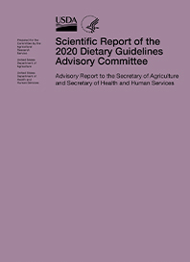
Scientific Report of the 2020 Dietary Guidelines Advisory Committee
The Dietary Guidelines Advisory Committee held 6 public meetings
The Committee’s report to the Secretaries contains its findings and conclusions for use in developing the 2020-2025 Dietary Guidelines for Americans
The integration of all the evidence identified two primary themes for the 2020-2025 DGA.
The Future Directions chapter identifies several important areas for future Dietary Guidelines.

Slide 43
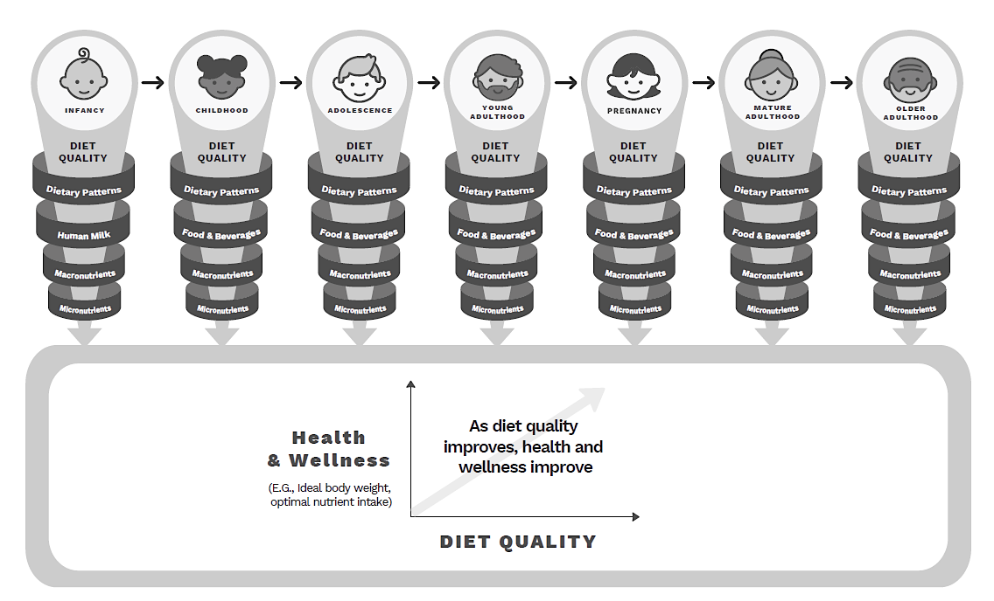
About the Dietary
Guidelines for Americans
About the Dietary
Guidelines for Americans
About the Dietary
Guidelines for Americans
Importance of the Dietary
Guidelines for Americans
About the Dietary
Guidelines for Americans
Importance of the Dietary
Guidelines for Americans
Importance of the Dietary
Guidelines for Americans
Major Themes
Life Stage
Healthy eating is important at each stage of life and has a cumulative effect on health over the lifespan.
Dietary Patterns
The core elements of a healthy dietary pattern described in the current Dietary Guidelines remain, with some refinements and more evidence supporting the recommendations.

Slide 44
Future Directions: Part E
Support for Federal data, Dietary Reference Intakes and related activities
Support for activities related to the Dietary Guidelines
Future directions for the Dietary Guidelines Process
Research recommendations
Research and data needs by chapter/topic
Tune into the next webinar in this series which focuses on the above: Wednesday, February 10th from 1 – 2 PM EST

Slide 45

Developing, Reviewing, and Translating the
Dietary Guidelines
Eve E. Stoody, PhD

Slide 46
Disclosures
AFFILIATION/FINANCIAL INTERESTS (prior 12 months) | ENTITIES
Grants/Research Support | None
Scientific Advisory Board/Consultant/Board of Directors | None
Speakers Bureau | None
Stock Shareholder | None
Employee | U.S. Department of Agriculture
Other | None

Slide 47
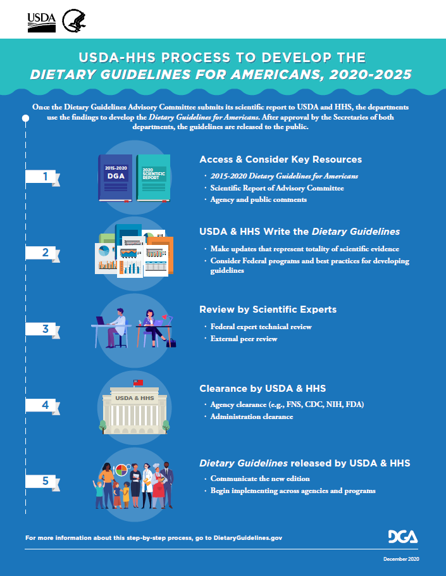
Process to Develop the Dietary Guidelines
Involves 5 steps of iterative writing, review, and revision
Conducted by a writing team of Federal nutritionists from USDA and HHS and includes review by Departmental and external scientists
Grounded in science
The process to develop the 2020-2025 Dietary Guidelines is used as an example, but these steps have remained consistent over time.

Slide 48
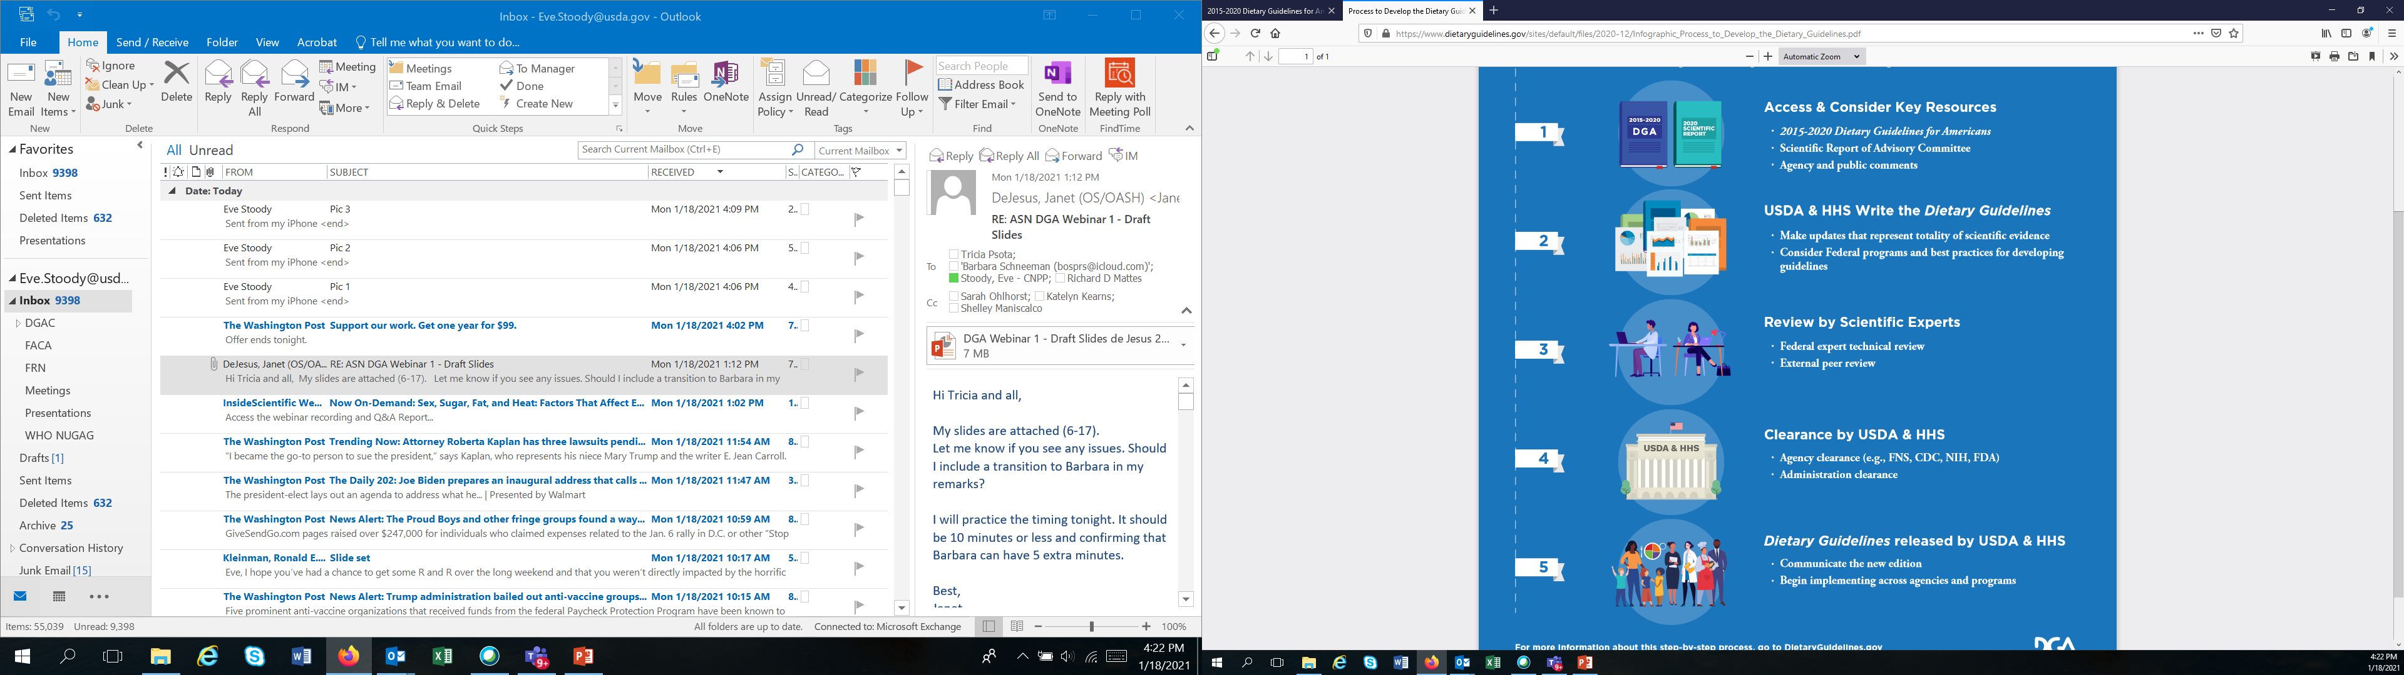
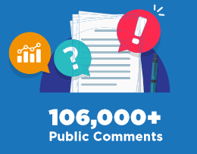
Writing the Dietary Guidelines
Each edition of the Dietary Guidelines builds on the preceding edition, with the scientific justification for revisions informed by the Advisory Committee’s Scientific Report, consultation with subject matter experts within Federal agencies, and consideration of comments from these agencies and the public
Additional inputs: Existing Federal guidance and Dietary Reference Intakes from the National Academies
Of these…
38,000+
On Report
Notes:
Inputs into the process
https://www.gsa.gov/policy-regulations/policy/federal-advisory-committee-management/finding-information-on-faca-committees/faca-101

Slide 49
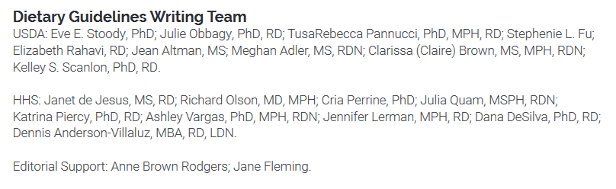
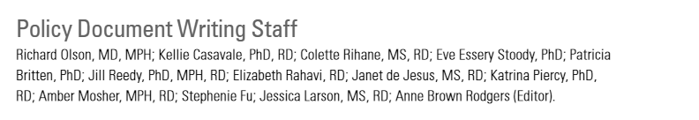
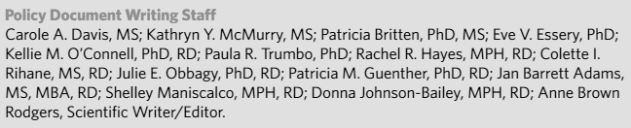
The Writing Team
2020
13-20 members
Coordinated by USDA Center for Nutrition Policy and Promotion and HHS Office of Disease Prevention and Health Promotion
Equal representation from USDA and HHS
Most (80%) supported the respective Dietary Guidelines Advisory Committee
Federal nutritionists with expertise in the Dietary Guidelines, Federal nutrition programs, and/or nutrition communications; science writer
2015
2010
Notes:
The writing team includes Federal nutrition scientists with expertise in the Dietary Guidelines and related research and programs as well as specialists with expertise in communicating nutrition information.

Slide 50
Writing the Dietary Guidelines
Totality of scientific evidence:
  Because components of the diet are interconnected, there’s not a one-to-one relationship between a question or conclusion statement and a recommendation
  Writing team looks across all the questions and evidence reviewed using the three approaches
Consideration of Federal programs:
  Age groupings used in the Dietary Guidelines align with Federal programs
  Evolved from 20-page pamphlet to 164-page book to provide details to support Federal programs
  Integrates existing Federal guidance
Concurrent with this step is the development of the designed product
Notes:
Key tenets of writing the Dietary Guidelines are that it must:
Represent the totality of the evidence examined
Address the needs of Federal programs
Reduce unintended consequences
Follow best practices for developing guidelines
Use plain language

Slide 51
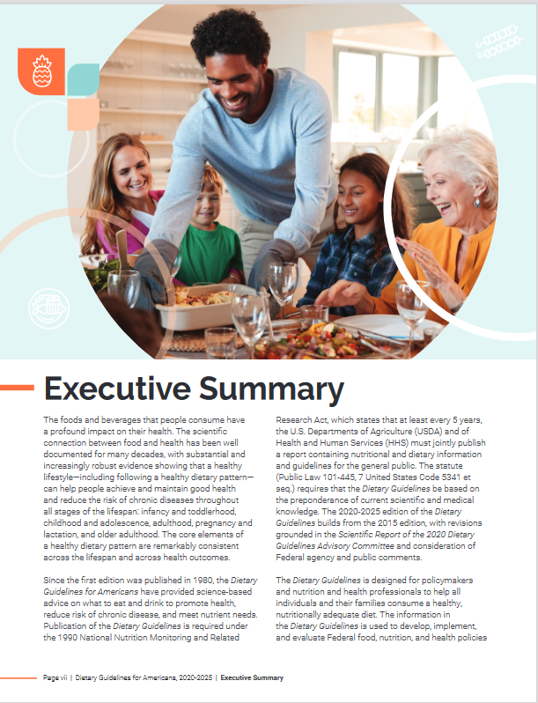
From the Committee’s Report to the Dietary Guidelines: Major Themes
The Committee’s Report is integral in identifying the major themes to highlight that reflect current public health priorities and evolving science.
2020-2025 Dietary Guidelines:
“The first is its recognition that diet-related chronic diseases, such as cardiovascular disease, type 2 diabetes, obesity, and some types of cancer, are very prevalent among Americans and pose a major public health problem.”
“The second is its focus on dietary patterns.“
“The third is its focus on a lifespan approach.”

Slide 52
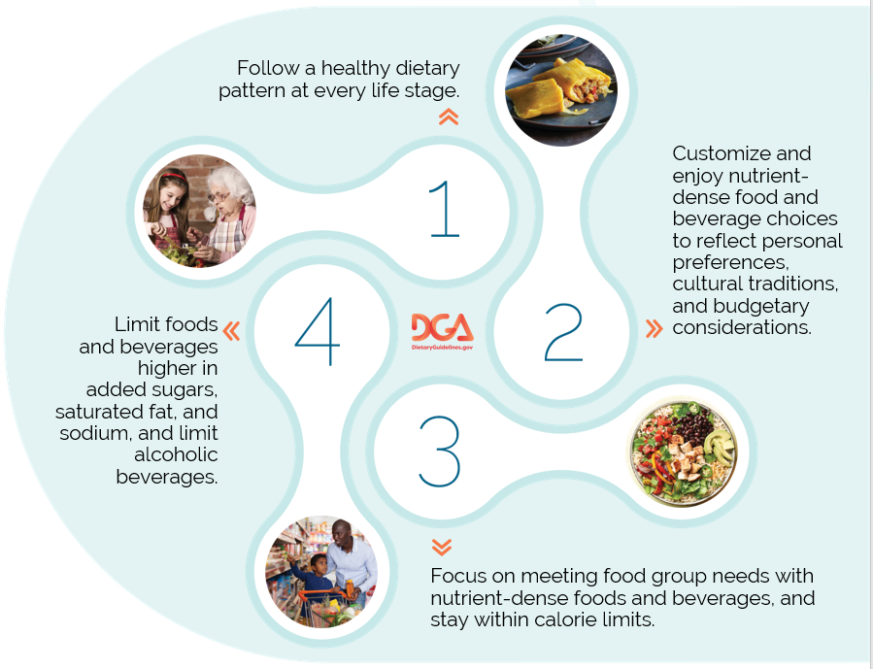
The Guidelines
Notes:
These themes are represented in the first guideline – follow a healthy dietary pattern at every life stage. The remaining guidelines were informed by discussion in the Cmte’s report, particularly the Integration Chapter.

Slide 53
From Conclusion Statements to Advice
to Guidance: Iron (Infants and Toddlers)
Data Analysis
Committee’s Advice: “Provide foods that are rich in iron and zinc, either intrinsically (e.g., meats) or due to fortification (e.g., iron fortified infant cereal), particularly during the second 6 months of life among breastfed infants. Iron requirements are lower in the second year of life than during infancy but a good source of iron is still needed.”
Dietary Guidelines Key Recommendation: “Encourage infants and toddlers to consume a variety of foods from all food groups. Include foods rich in iron and zinc, particularly for infants fed human milk.” [+ supporting text]
Current intakes of iron among infants and toddlers
Food Pattern
Modeling
Meeting iron recommendations through complementary foods
Iron from human milk/ infant formula or supplements and
health outcomes;
complementary feeding and health outcomes
NESR Systematic
Reviews

Slide 54
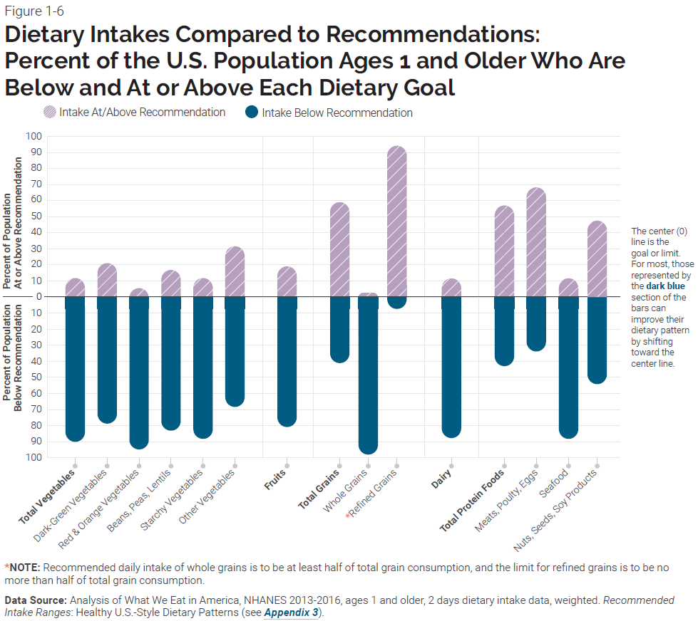
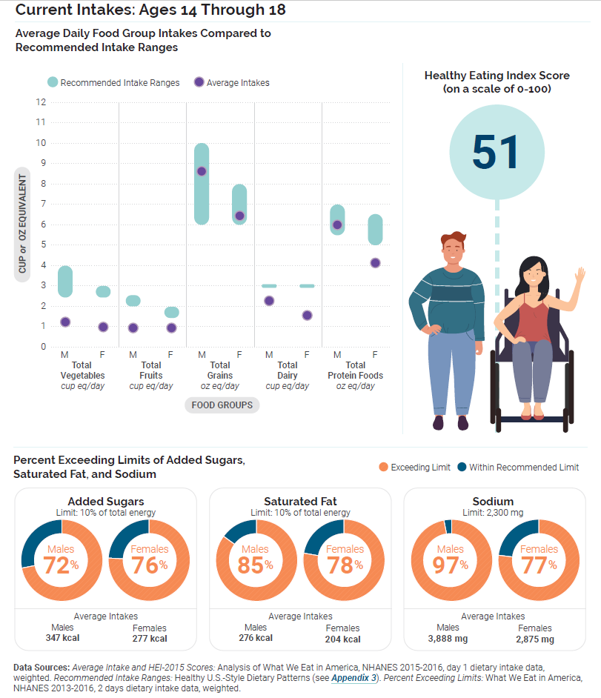
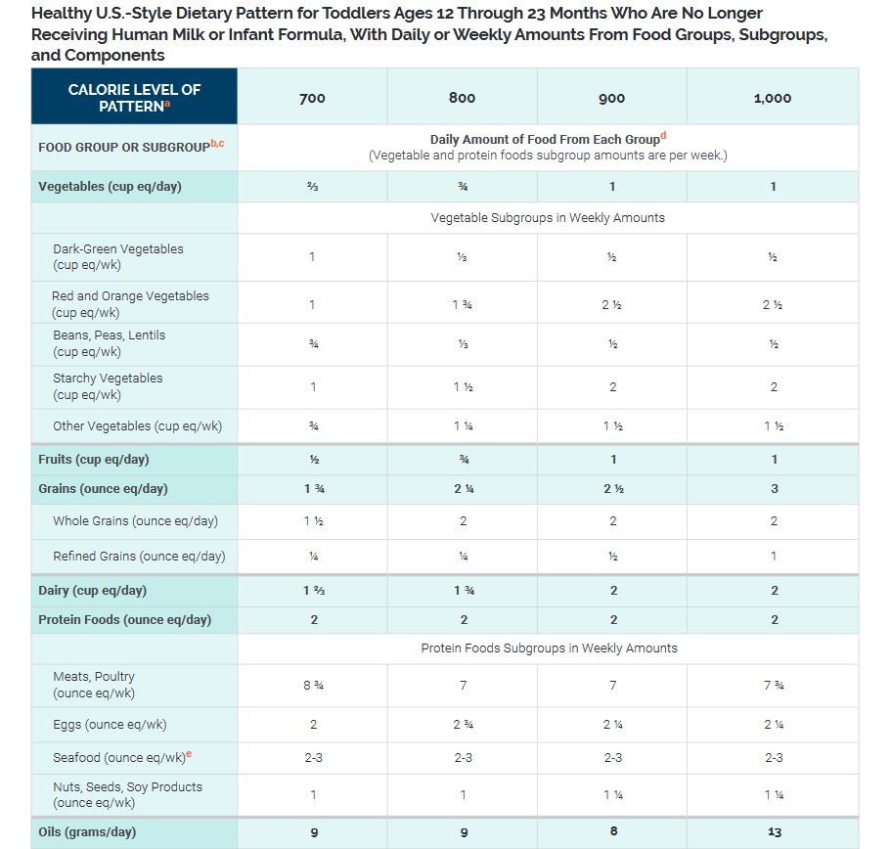
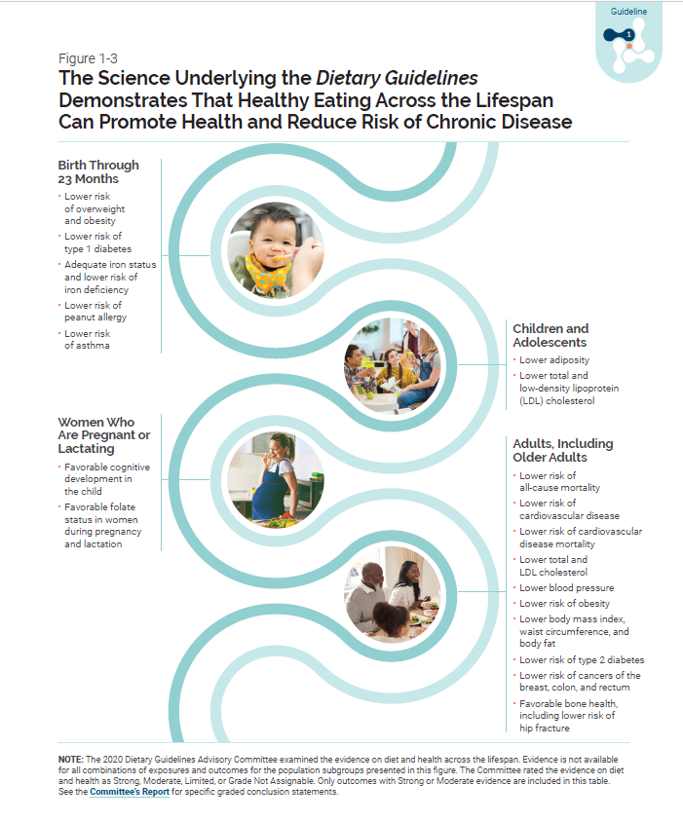
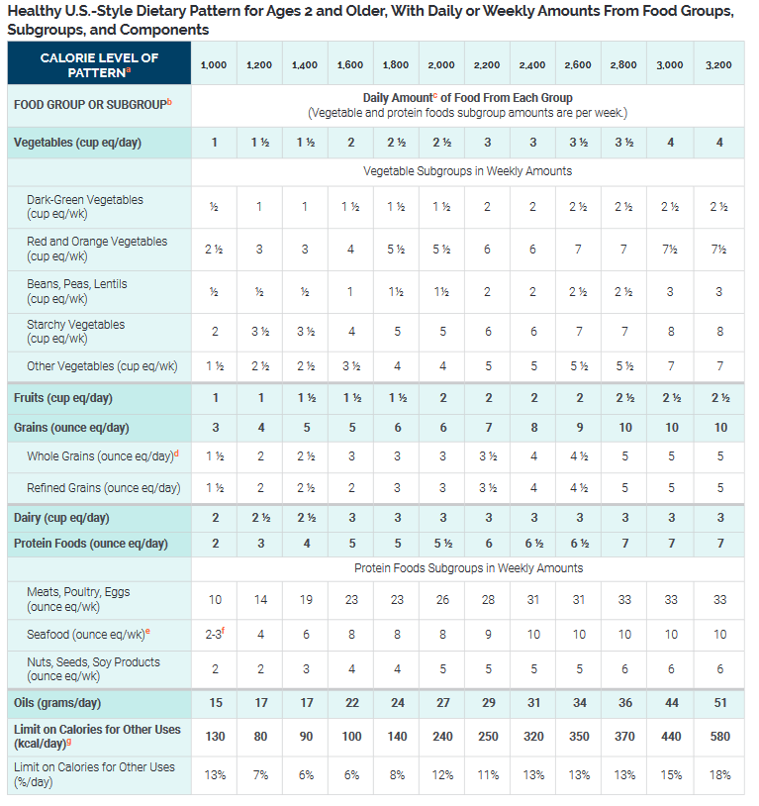
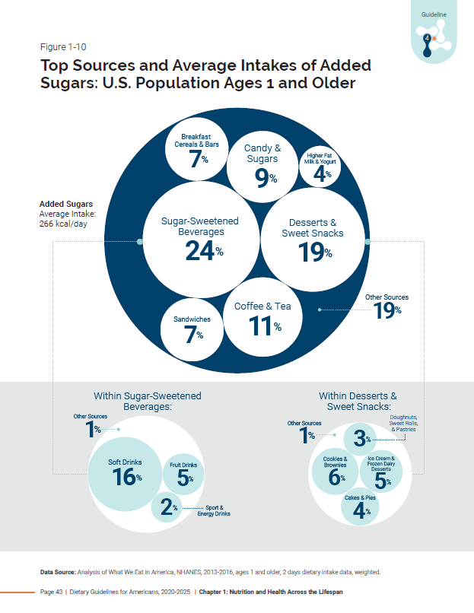
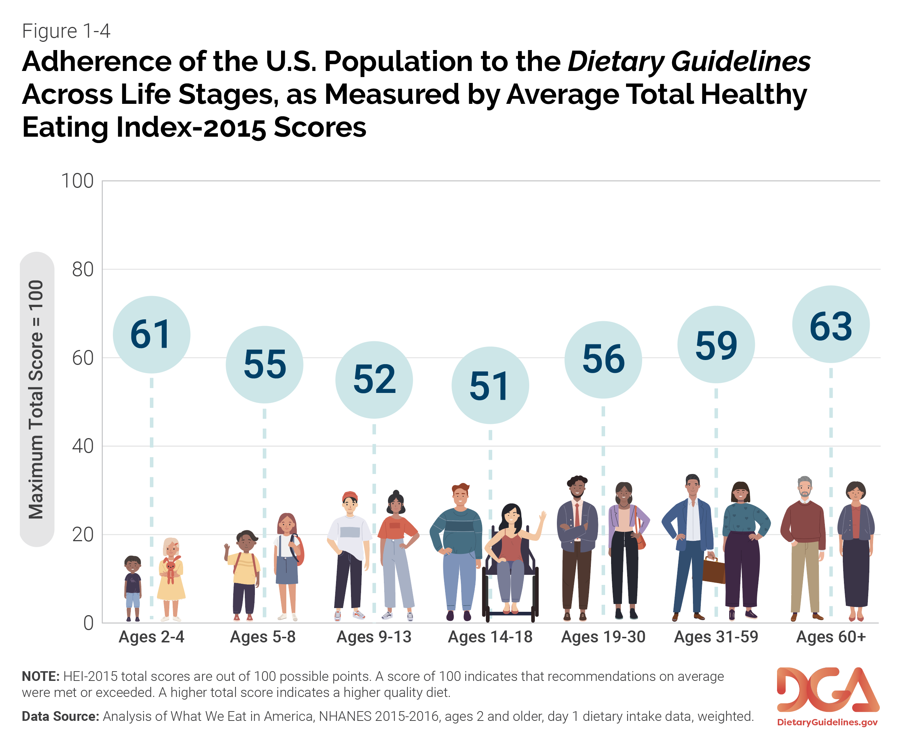
From the Committee’s Report to the Dietary Guidelines: Three Approaches
Food Pattern
Modeling
NESR Systematic
Reviews
Data Analysis
Notes:
24 tables and 33 figures

Slide 55
Review of the Dietary Guidelines
All or portions of the draft are sent to Federal subject matter experts for review and comment (revise based on comments)
Full draft is also sent to 6 to 8 external peer reviewers, including former members of the respective Dietary Guidelines Advisory Committee (revise based on comments)

Slide 56
Clearance of the Dietary Guidelines
Agency clearance includes all USDA and HHS agencies with nutrition programs
  Concur with no comments or provide minor or major comments (revise based on comments)
  If substantive revisions are made to the draft, additional review and clearance may be required
Administration clearance
  Reviewed by staff from the Office of the USDA Under Secretary of Food, Nutrition, and Consumer Services and HHS Assistant Secretary for Health and staff from the Offices of the Secretary of Agriculture and Secretary of Health and Human Services as well as Departmental communications staff (editorial and graphics review) and general counsel
  Culminates with review by the Secretary of Agriculture and Secretary of Health and Human Services, who are engaged throughout the development process

Slide 57
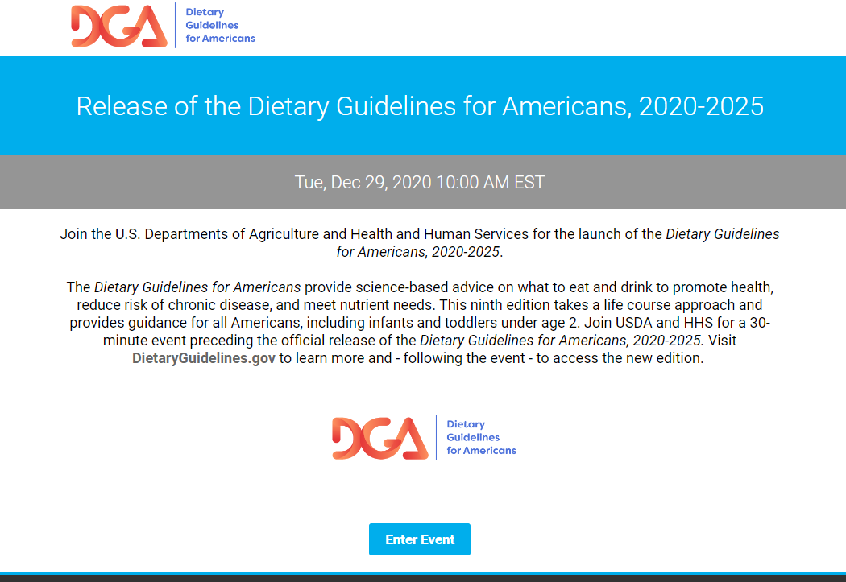

Release of the Dietary Guidelines
Advisory Committee briefing
Launch event
Media briefings
Congressional briefing
Ongoing: Federal briefings, presentations, and outreach

Slide 58
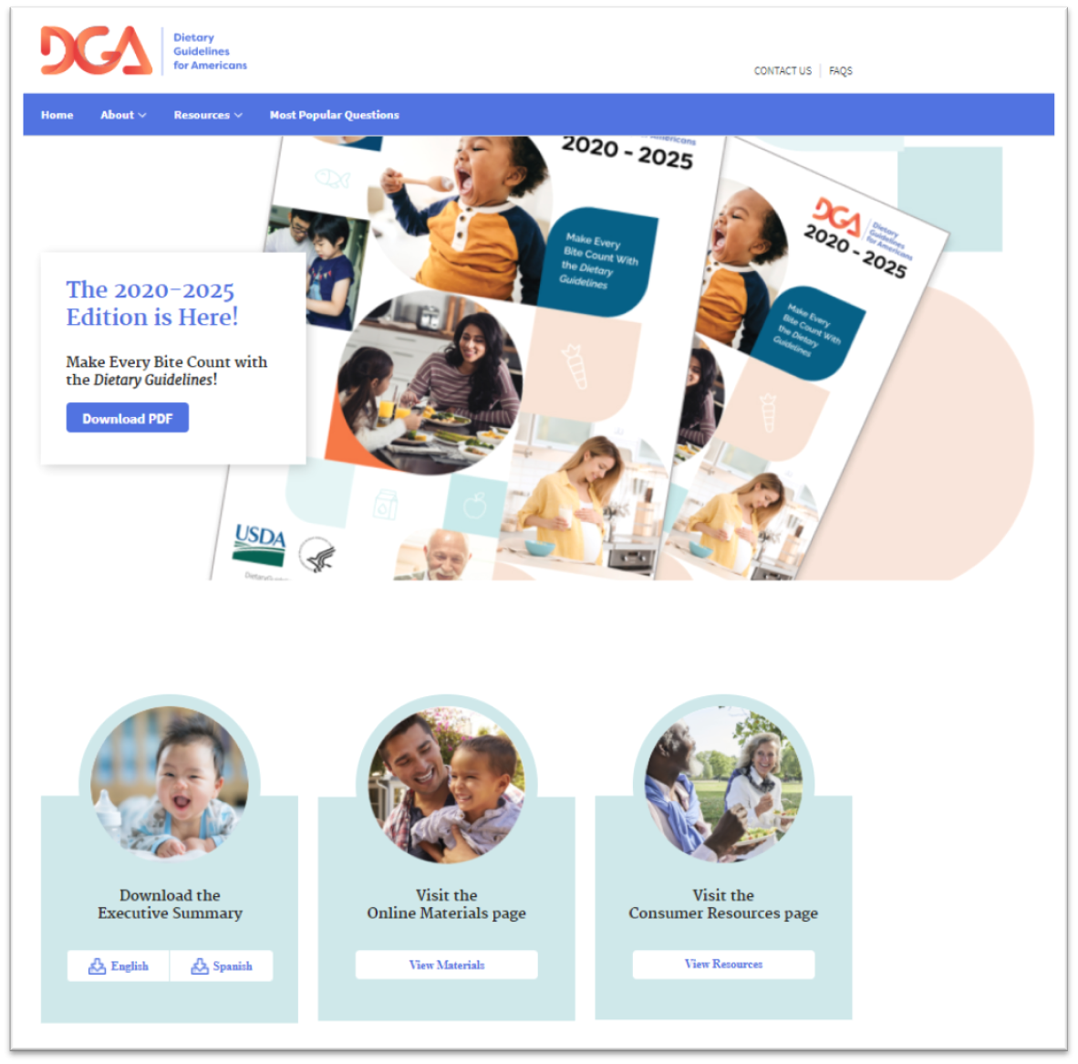
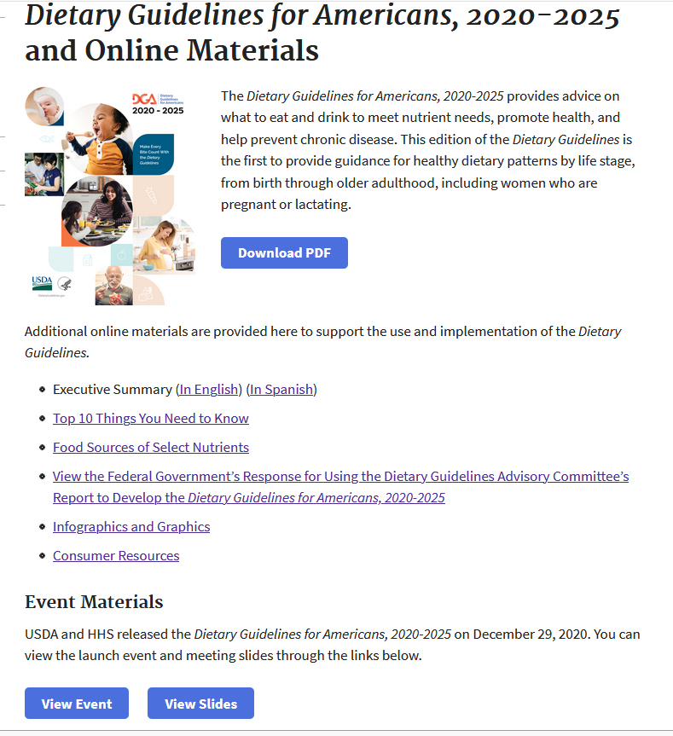
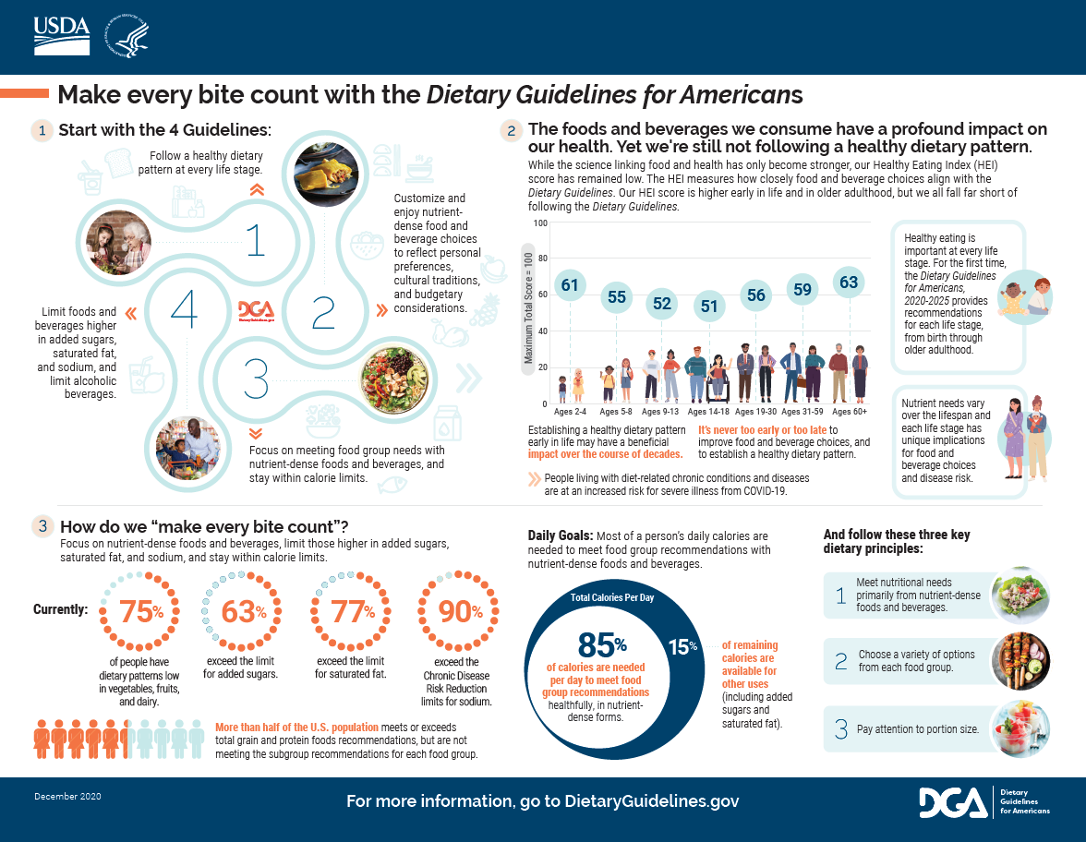
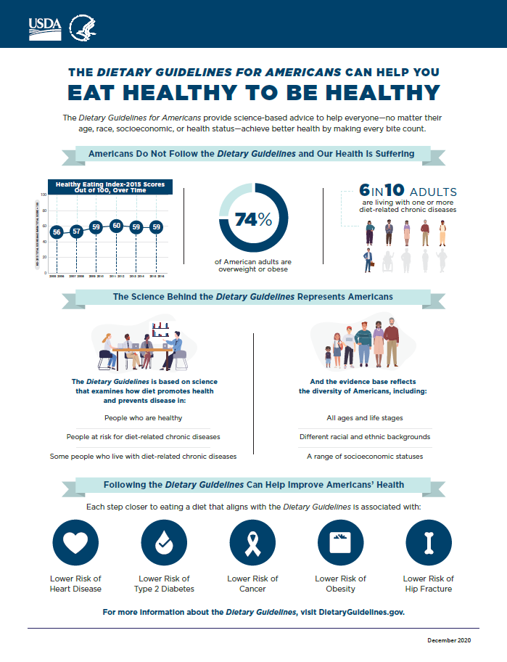
Release of the Dietary Guidelines
Sign up to receive updates about new materials at DietaryGuidelines.gov

Slide 59
Dietary Guidelines Implementation
Once the Dietary Guidelines is released, the Federal government begins implementing its recommendations and uses the Dietary Guidelines to support “speaking with one voice” on nutrition topics.
The Dietary Guidelines provides the foundation for Federal nutrition and health initiatives. It is within each Federal agency’s purview to determine how best to implement the Dietary Guidelines within its programs to serve its specific audiences.
Many opportunities exist for other sectors of society to implement the Dietary Guidelines in the multiple settings they influence, from home to school to work to community.
Notes:
Wherever people live, learn, work, play, and gather.

Slide 60


Implementing the Dietary Guidelines Through MyPlate
MyPlate is used by professionals to help people become more aware of and informed about making healthy food and beverage choices over time.
USDA’s Start Simple with MyPlate campaign offers resources to help Americans put the Guidelines into practice starting today.
The benefits of healthy eating add up over time, bite by bite. Small changes matter. Start Simple with MyPlate.

Slide 61
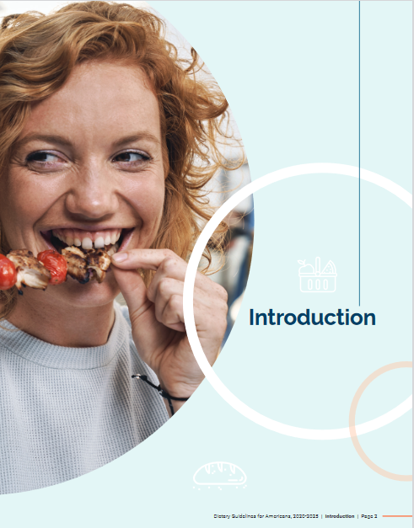
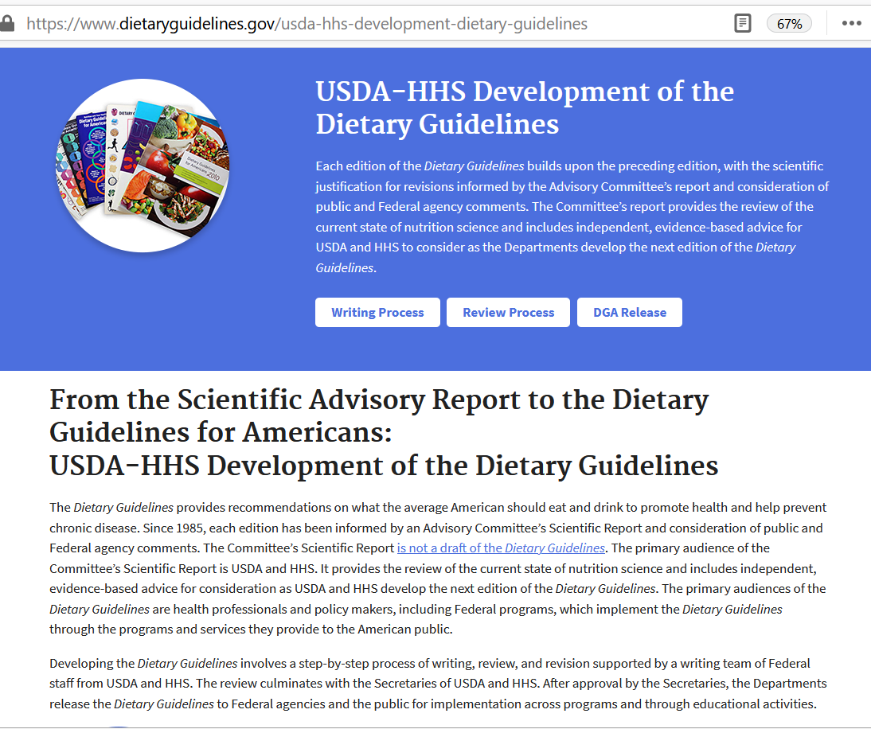
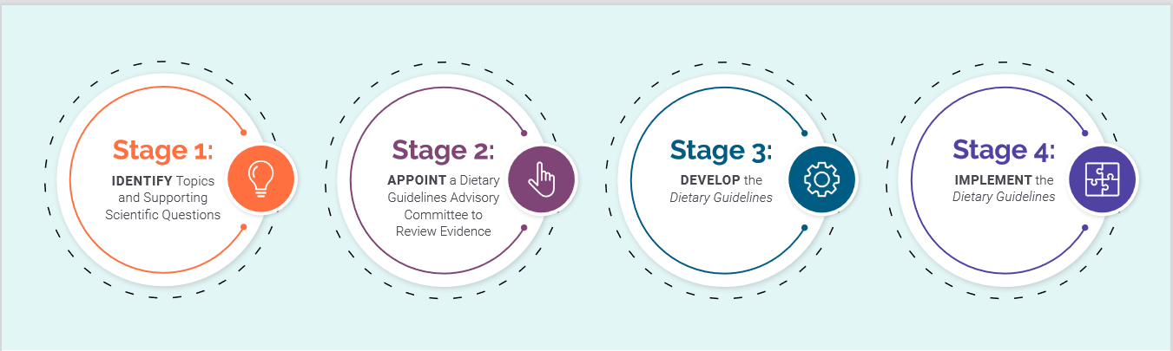
Learn More: DietaryGuidelines.gov
Notes:
In addition to the infographic that I’ve walked through during this presentation, more information on the process to develop the Dietary Guidelines is provided in the Introduction of the current edition and at DietaryGuidelines.gov.

Slide 62
Notes:
Questions

Slide 63
Discussion

Slide 64
Join Us!
Webinar 2: Utilizing Evidence Gaps Identified by the 2020 Dietary Guidelines Advisory Committee Report to Inform Research Priorities
Wednesday, February 10th 1-2 PM EST
Webinar 3: Designing, Implementing and Presenting Research to be Reviewed by the 2020 Dietary Guidelines Advisory Committee
Wednesday, March 10th 1-2 PM EST

Slide 65

Special Thanks To

Slide 66
Nutrition 2021: Abstract Reminders
Abstract submission deadline: February 8, 2021
Abstract acceptance notifications sent: March 8, 2021
Abstract programming assignments sent: April 5, 2021

Slide 67
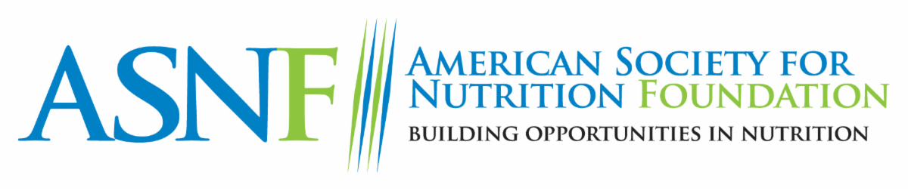
This webinar series is brought to you by the ASN Foundation. Your donation to the ASN Foundation helps advance the science, education, and practice of nutrition.

